Slide 1
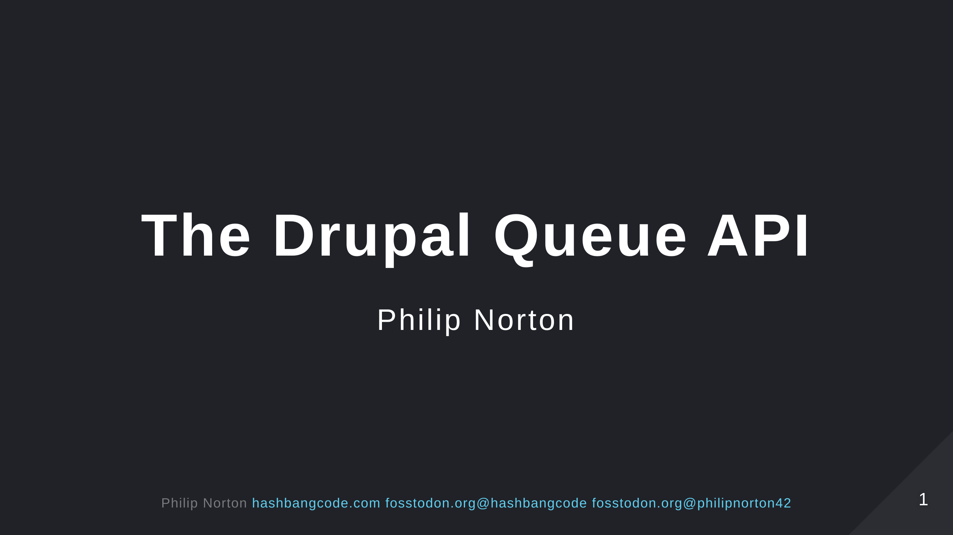

Slide 2

Notes:
- Doing Drupal for about 15 years. - Programming in general for about 20 now. - That is a picture of a Lily58 mechanical keyboard.

Slide 3
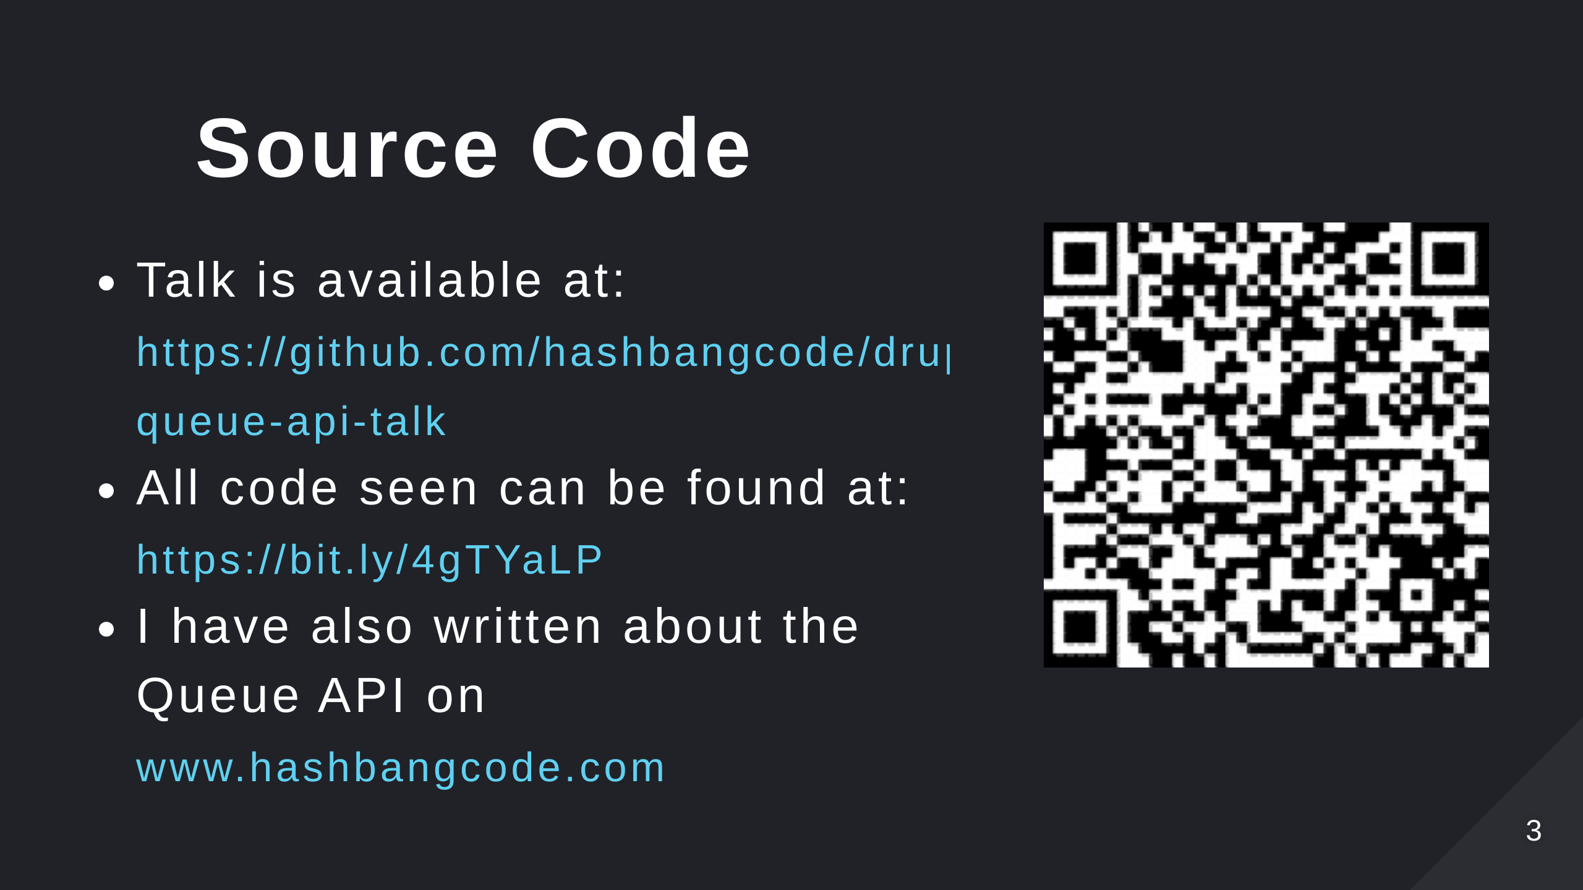
Notes:
- Scan the QR code for the talk repo. Which has links to all of the resources you need.

Slide 4
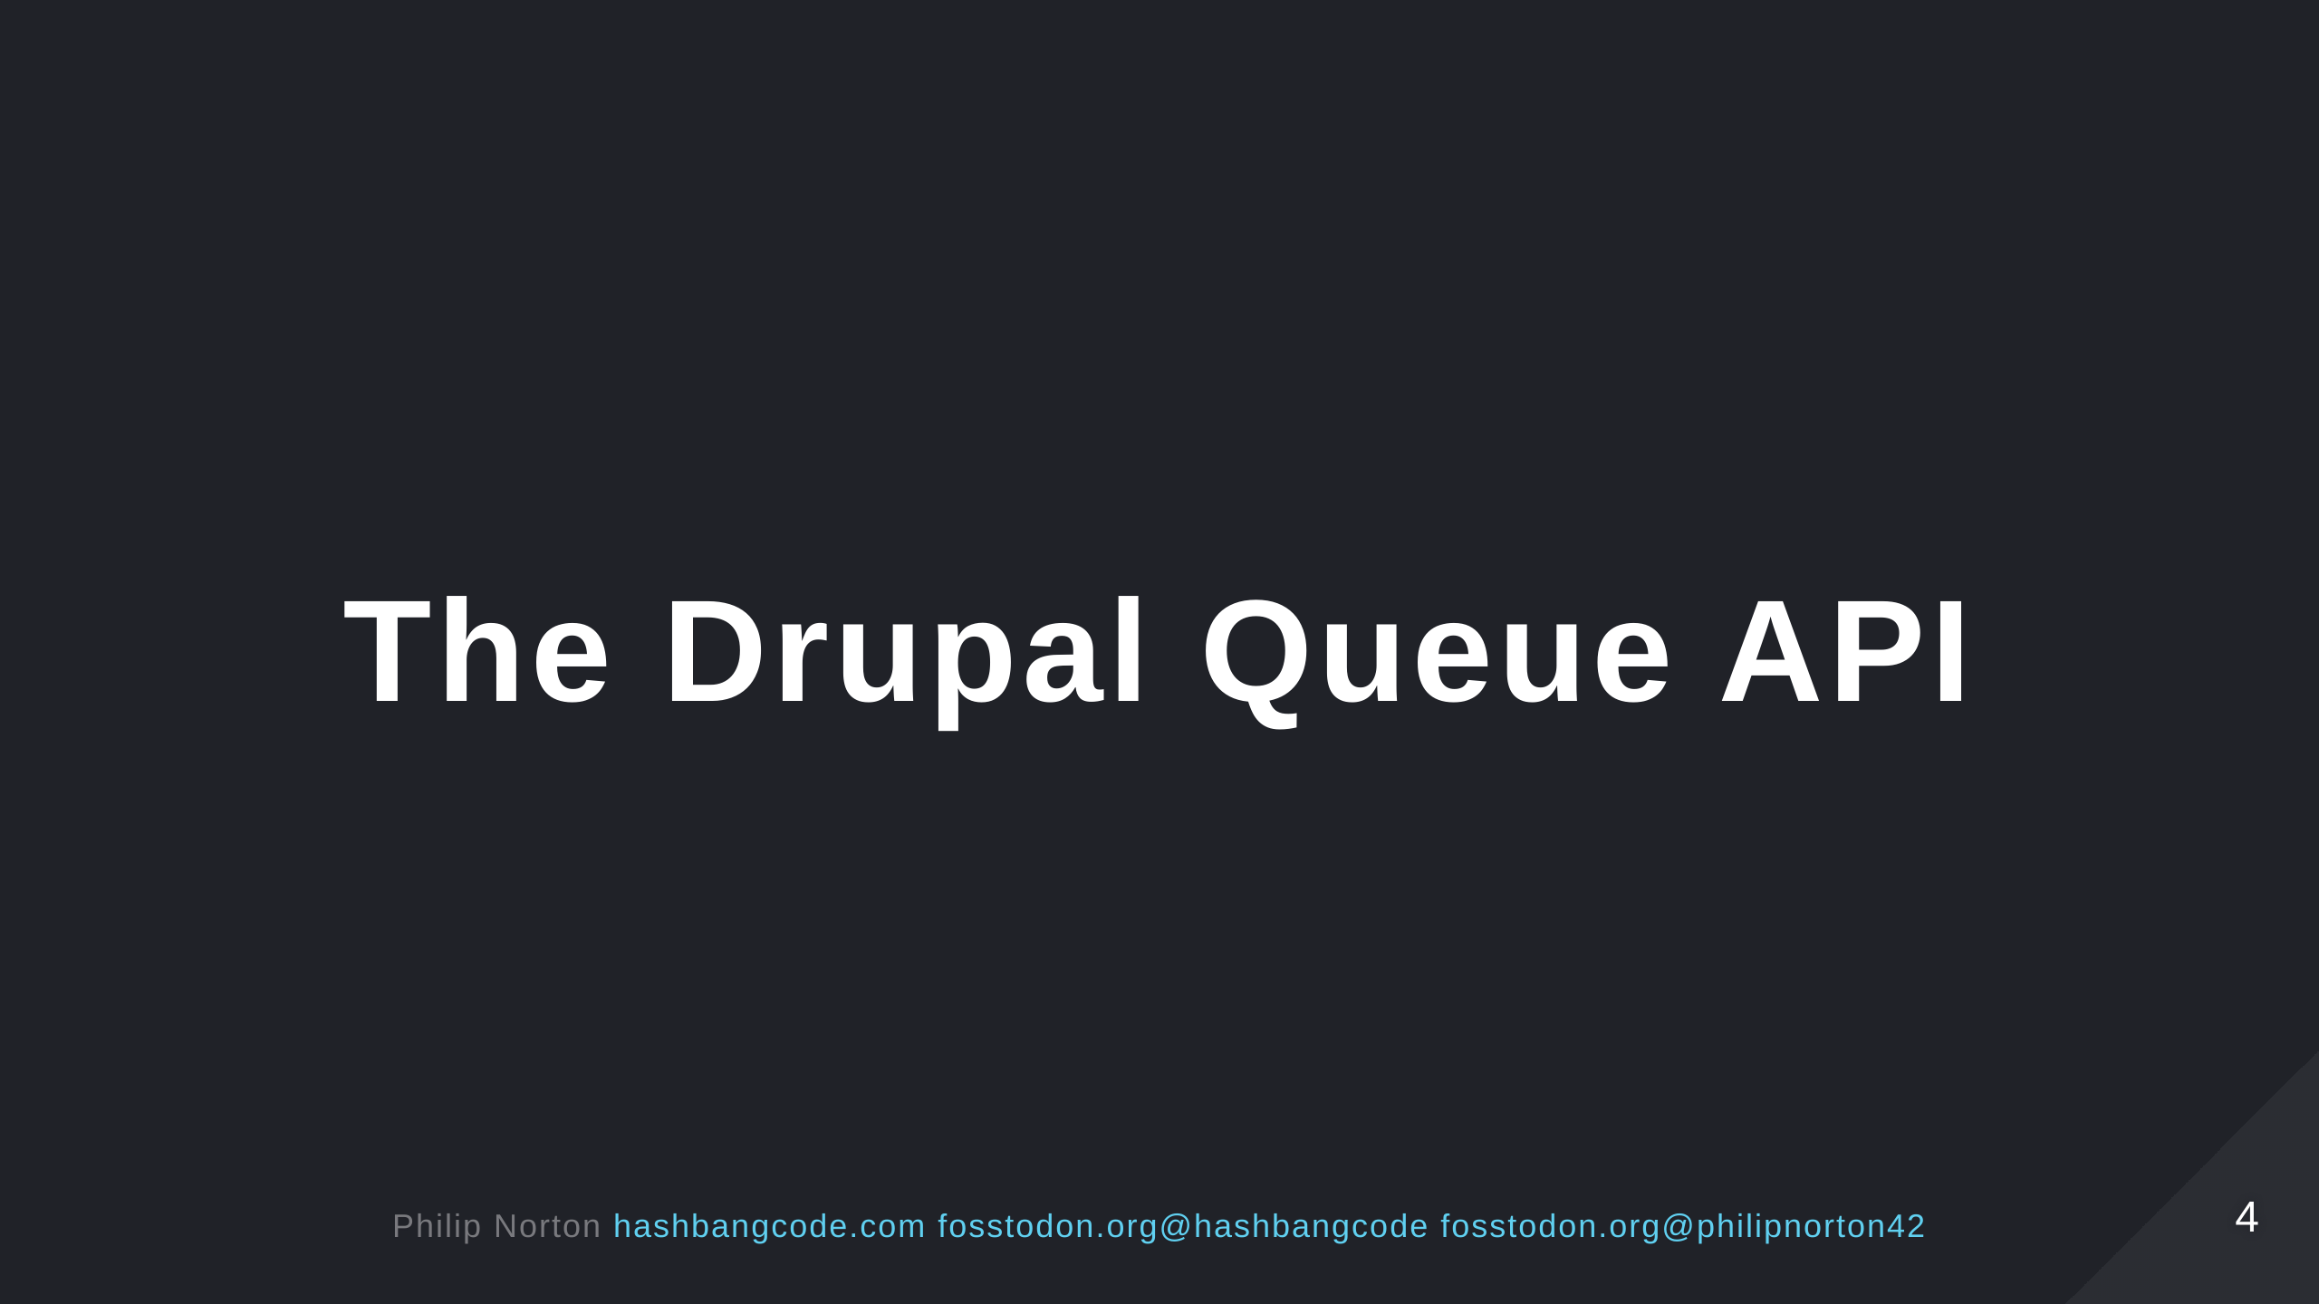
Notes:
The Drupal Queue API is a system that allows us to split up large tasks that will be run asynchronously so that we don't overload the web server. It is also the system that powers the Batch API. In this session we will look at why we need the Drupal Queue API and how it prevents issues. We'll then do a dive into the code surrounding the Queue API and how to run your own queue operations. There will be a few demos on running the Queue API to perform some simple tasks. Finally, we'll look at how Drupal uses the Queue API internally and some use cases of the Queue API in contributed modules.

Slide 5
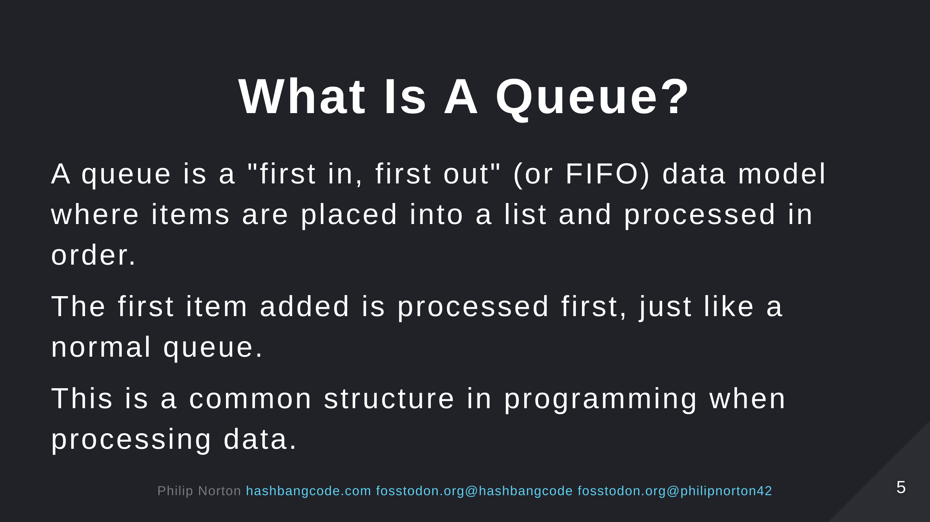

Slide 6
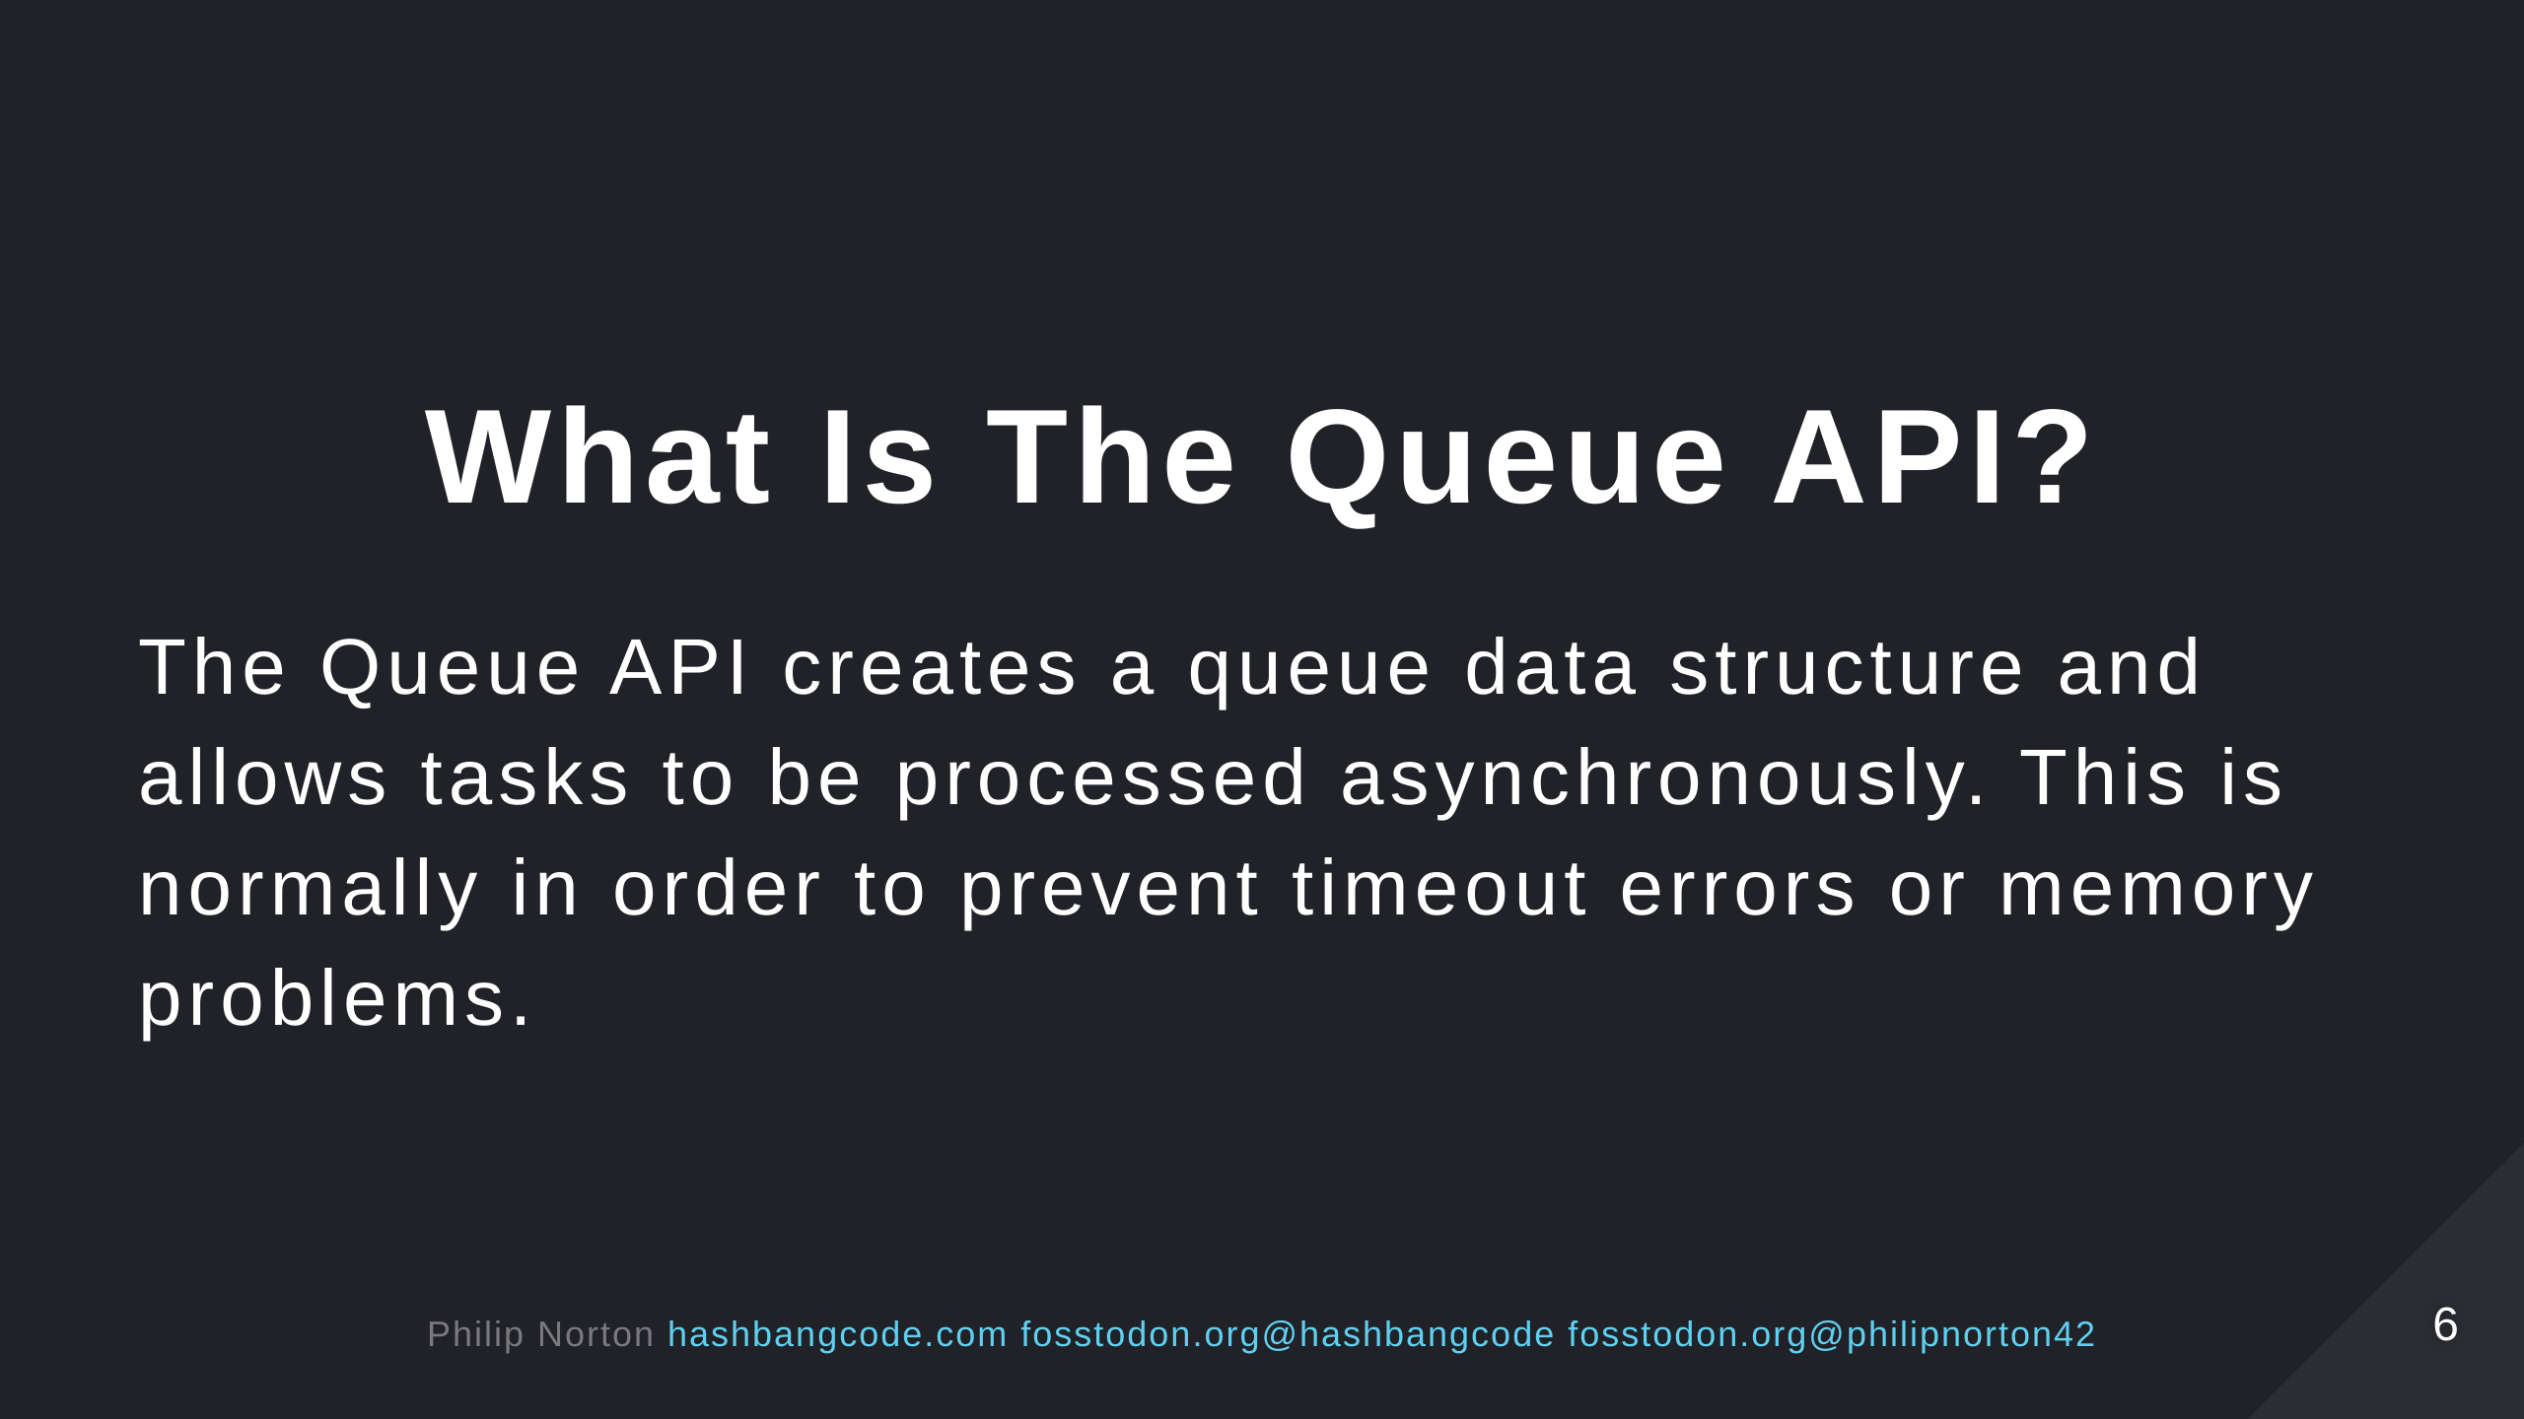

Slide 7
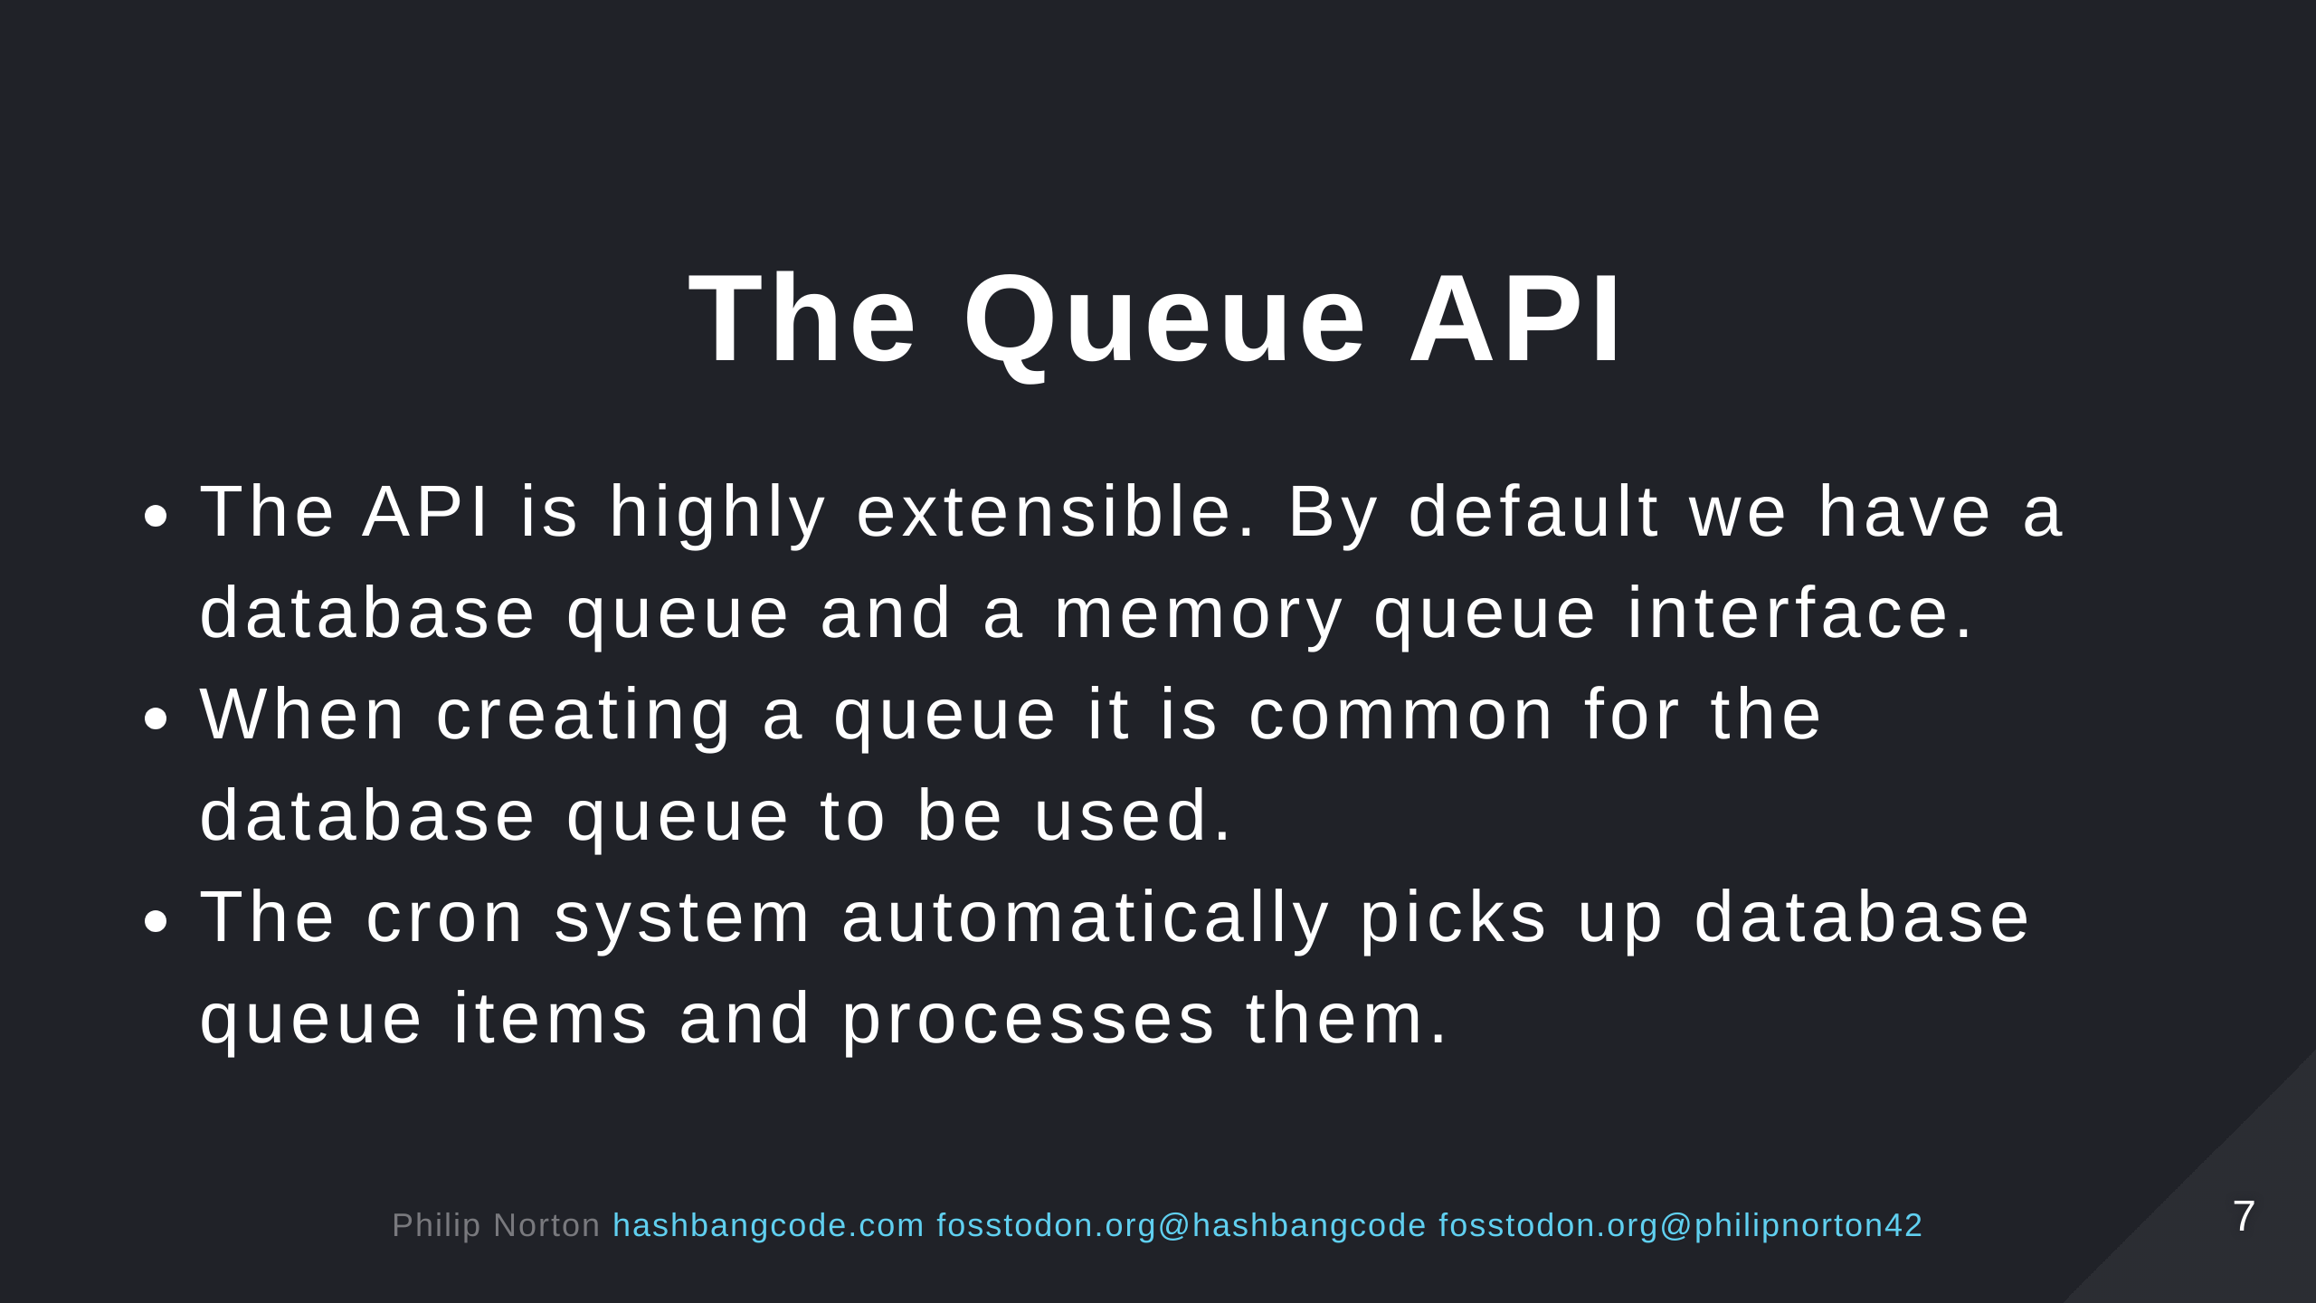

Slide 8
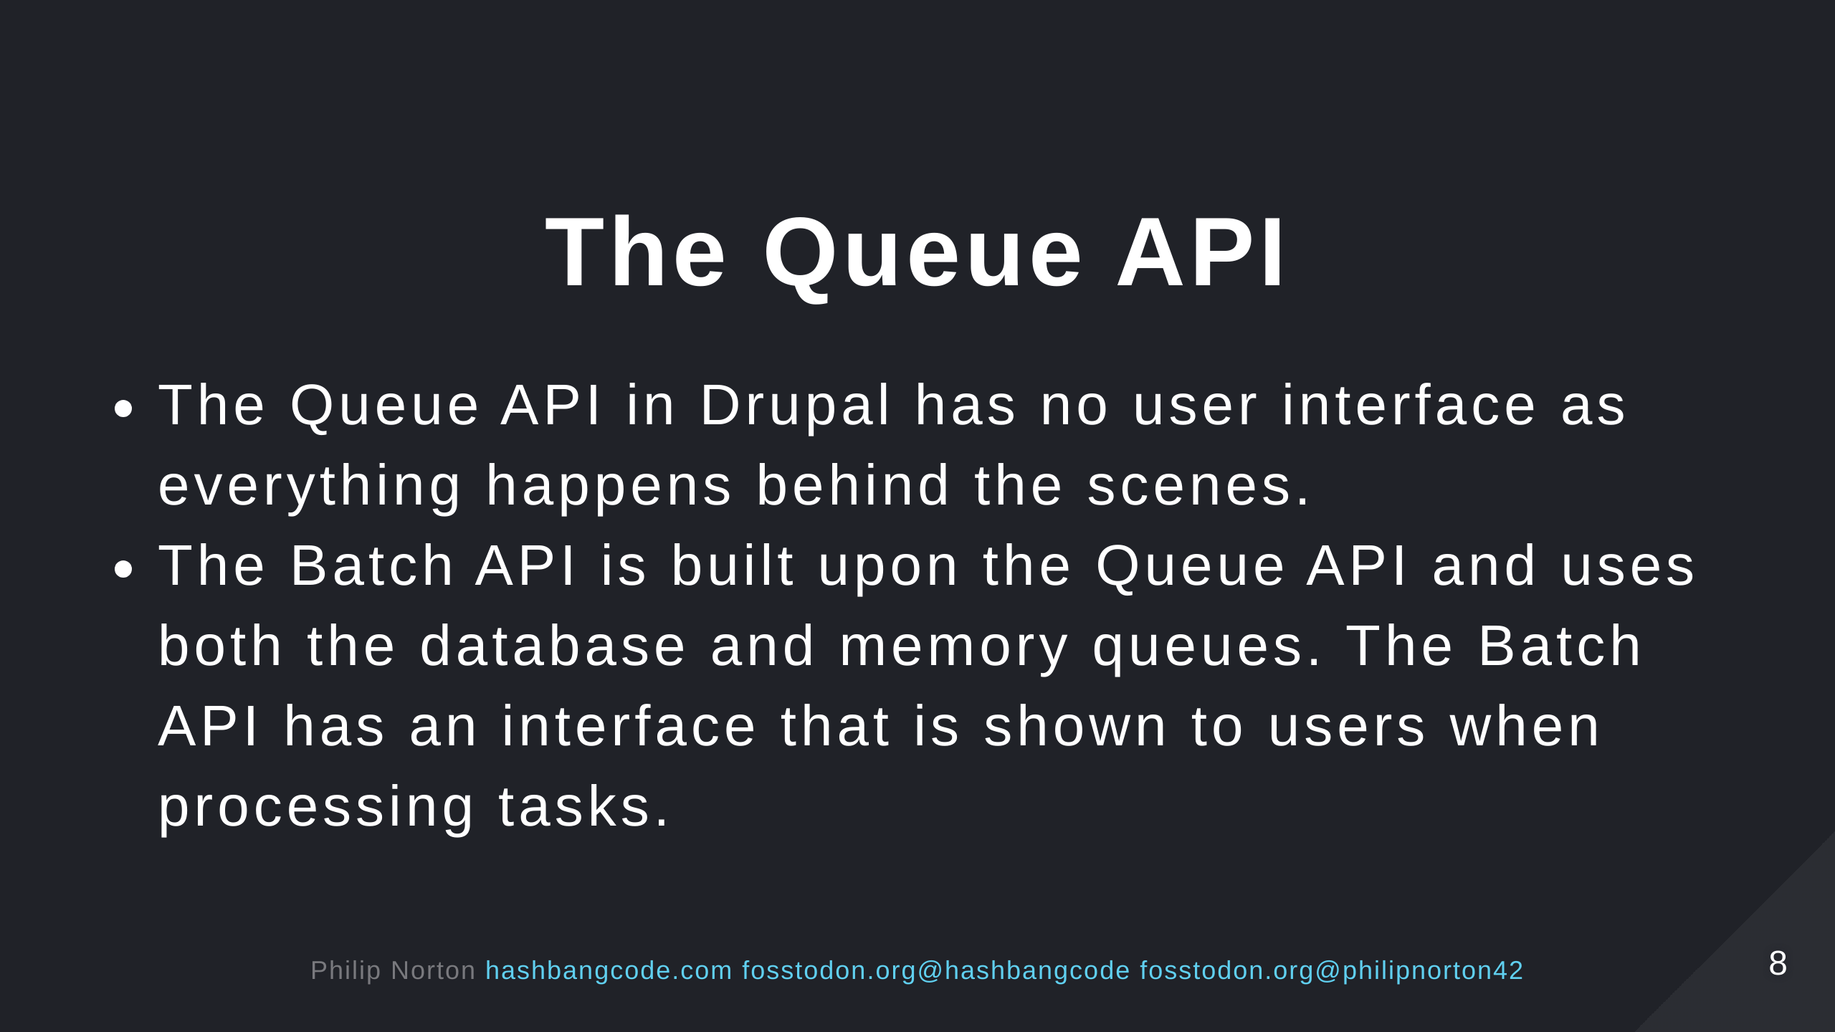

Slide 9
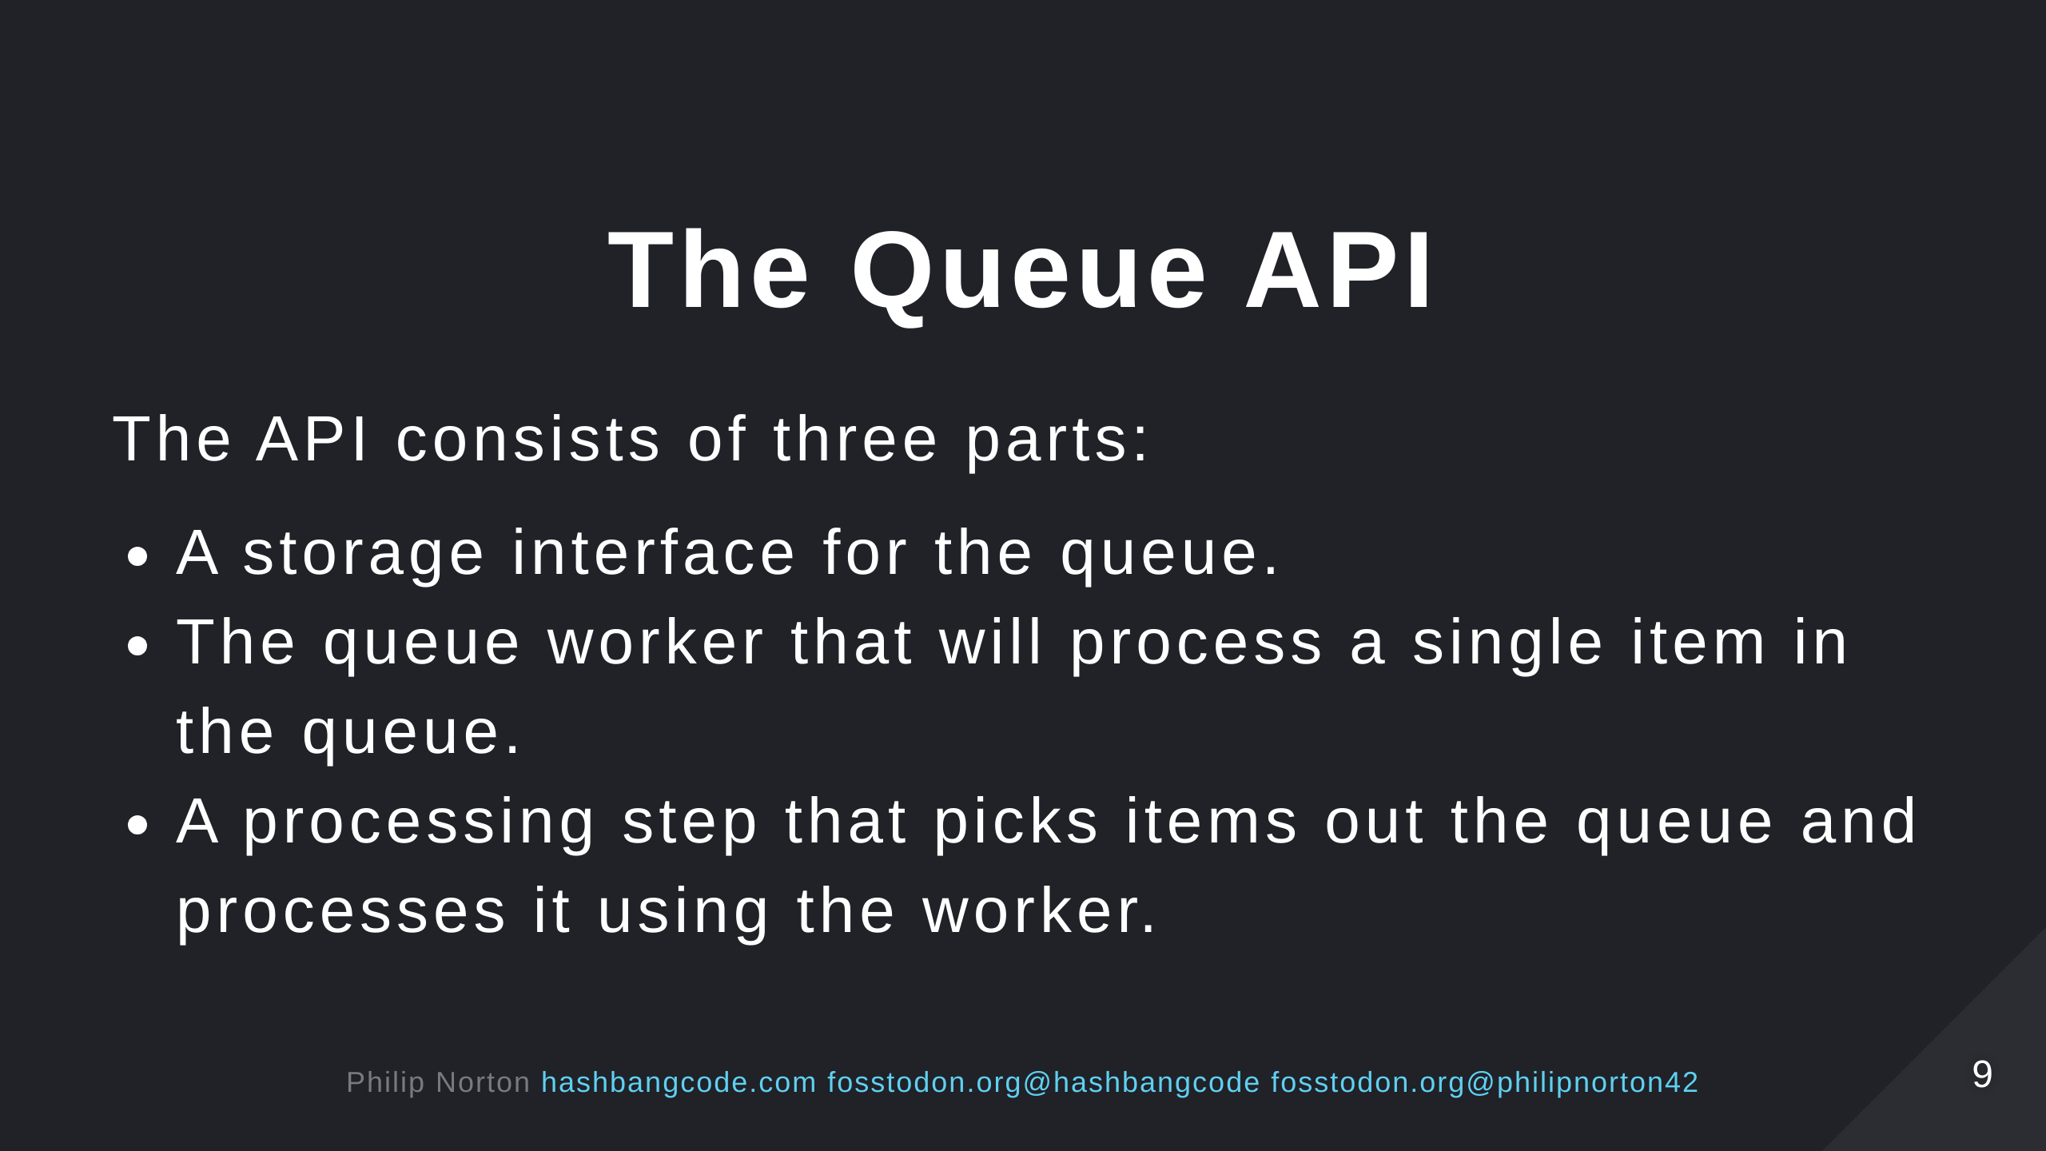
Notes:
There are some internal queues that you can use, but you will normally want to create your own queues for processing data.

Slide 10
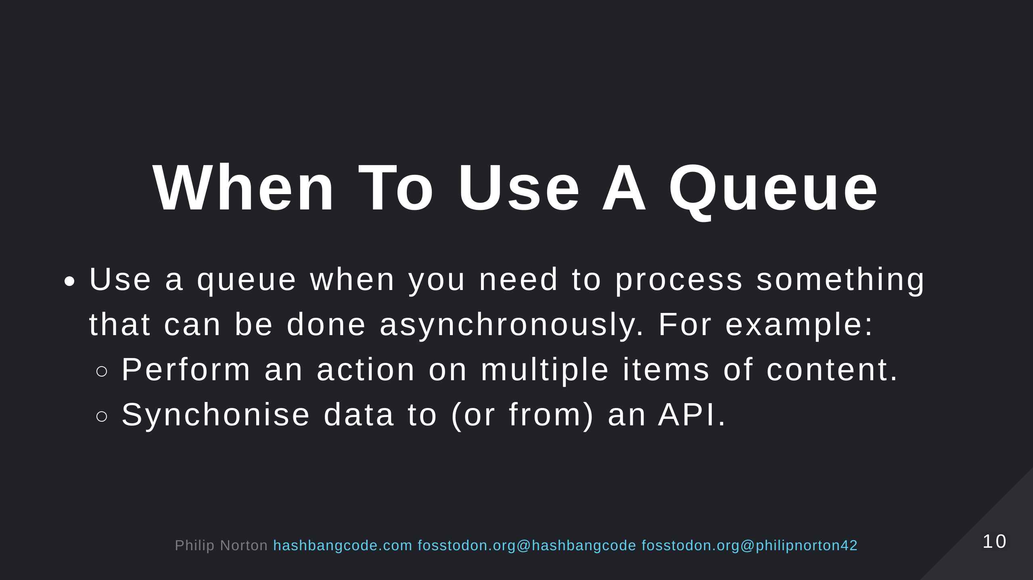

Slide 11
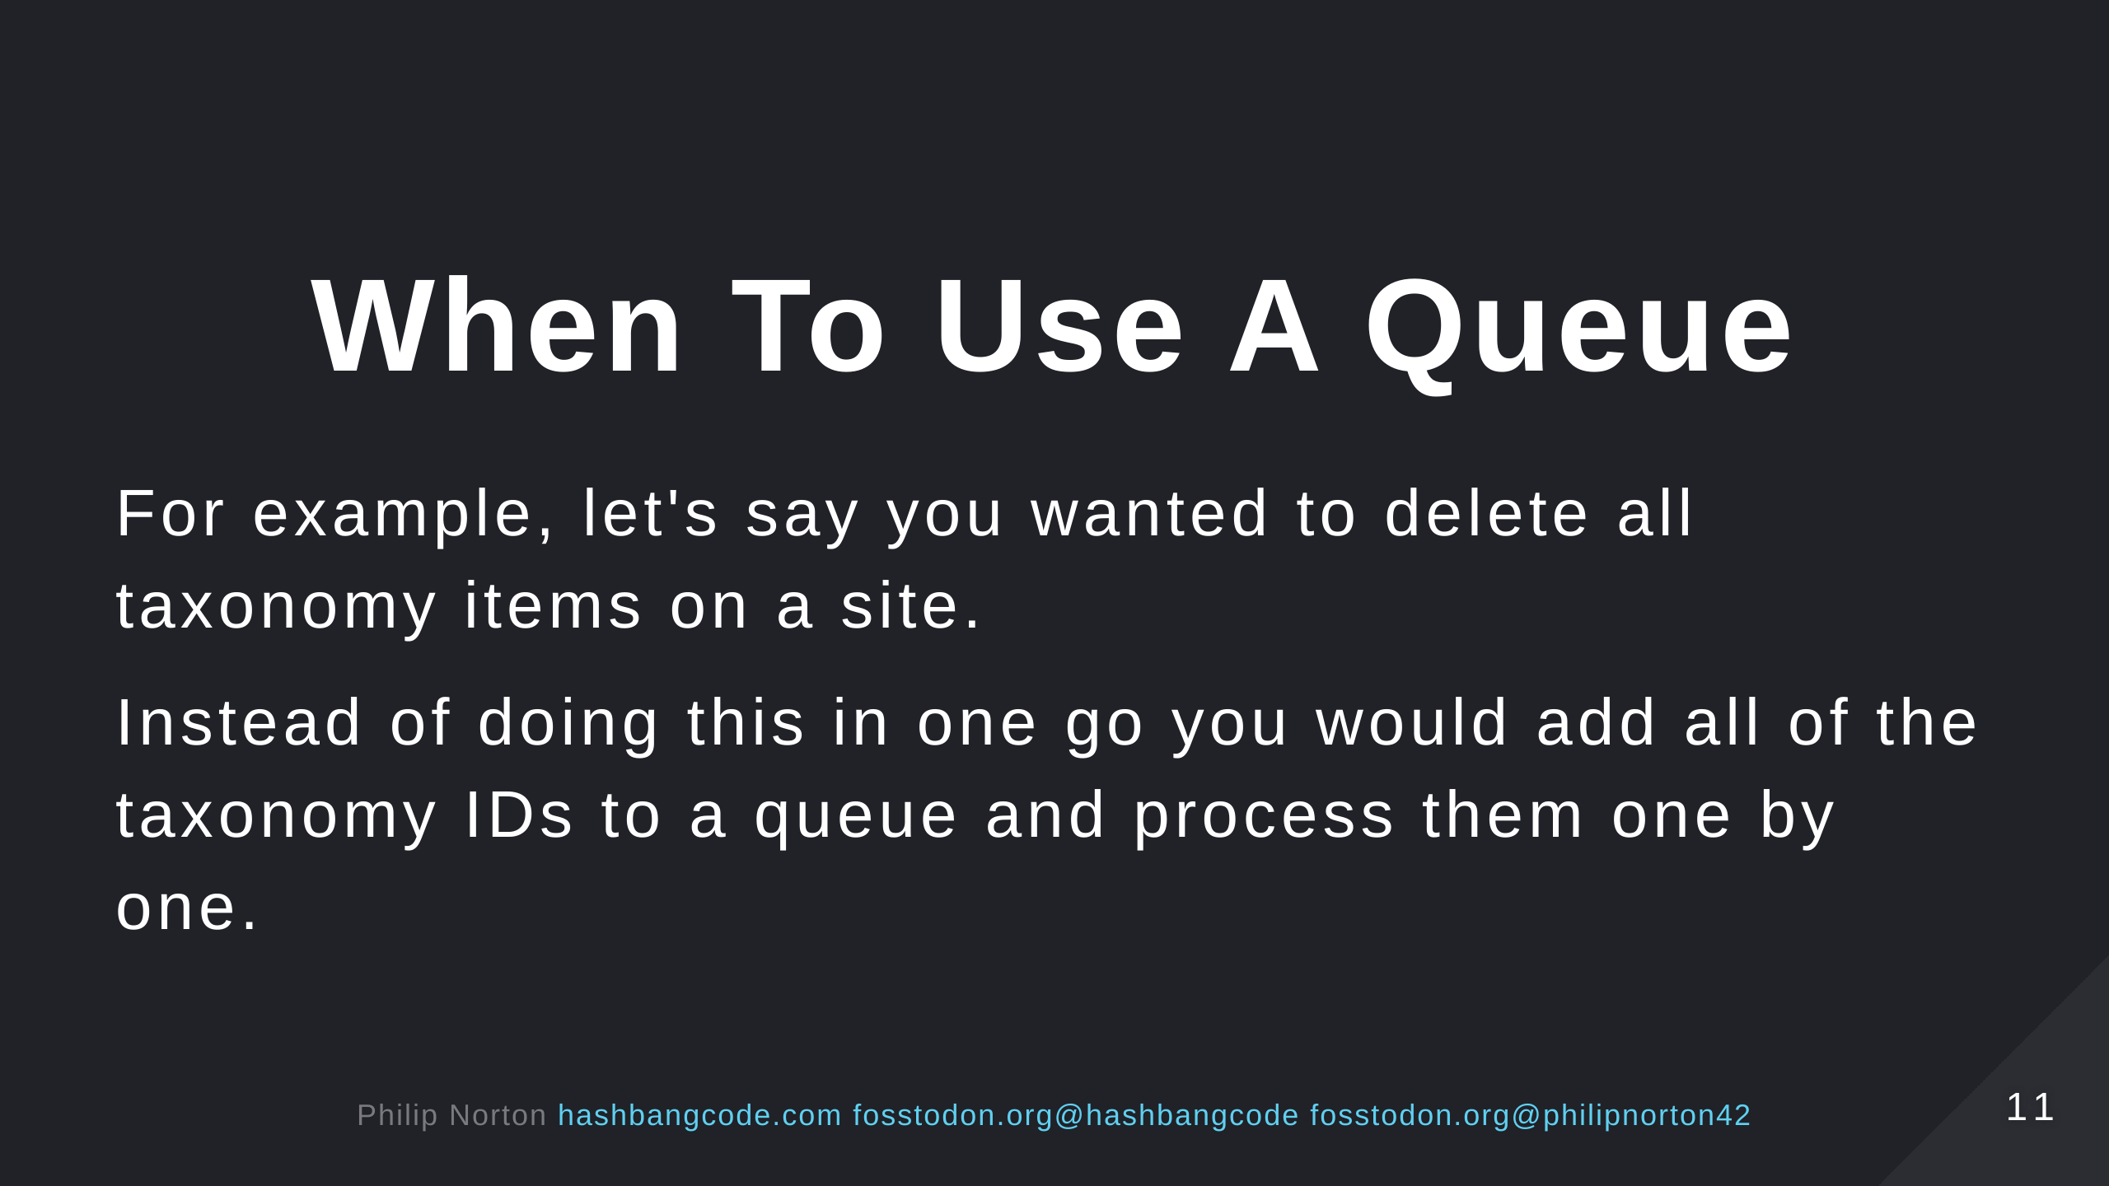
Notes:
We'll come onto more examples later, but for now assume that it is possible to throw data into a queue for later processing.

Slide 12
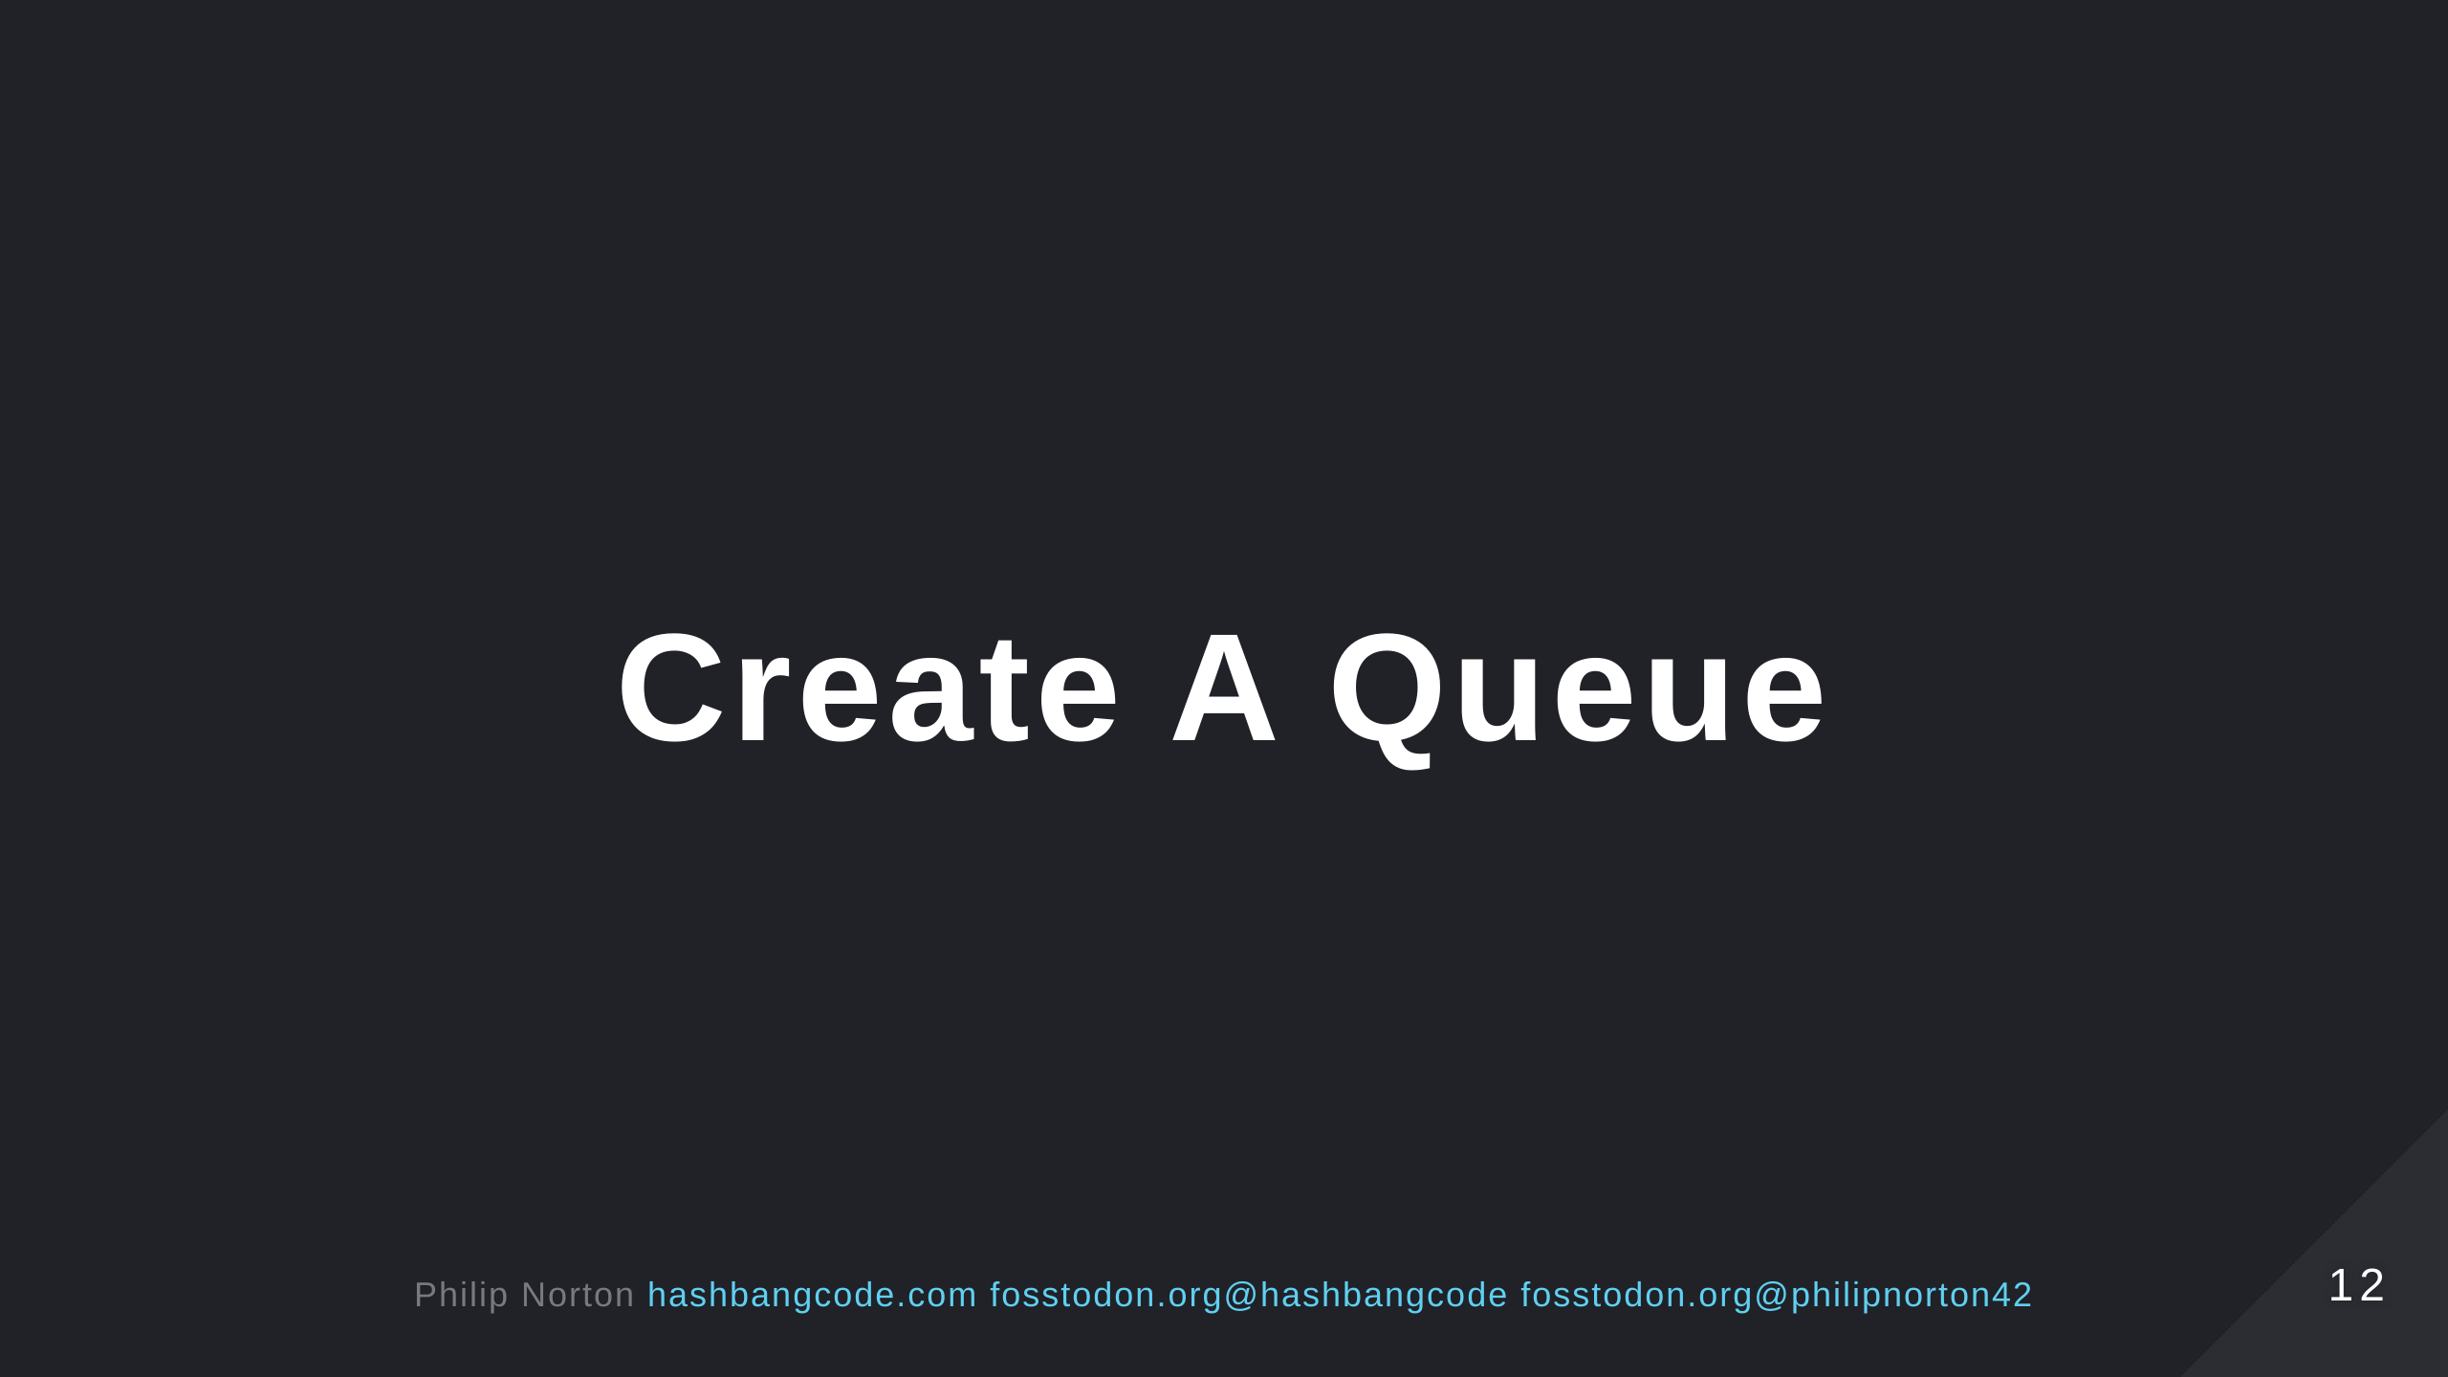

Slide 13
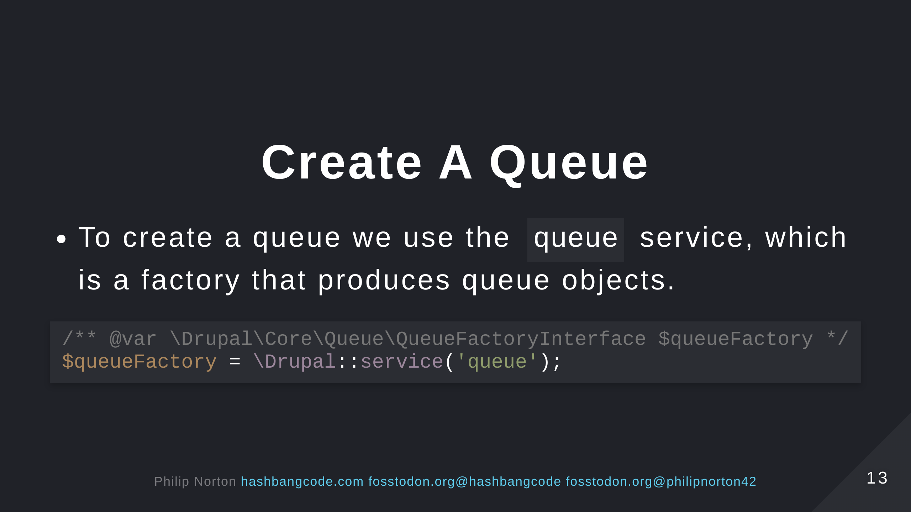

Slide 14
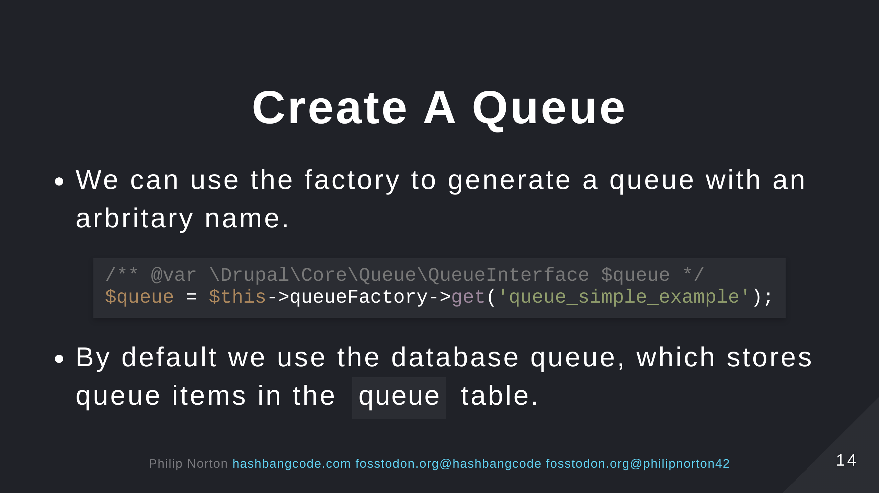

Slide 15
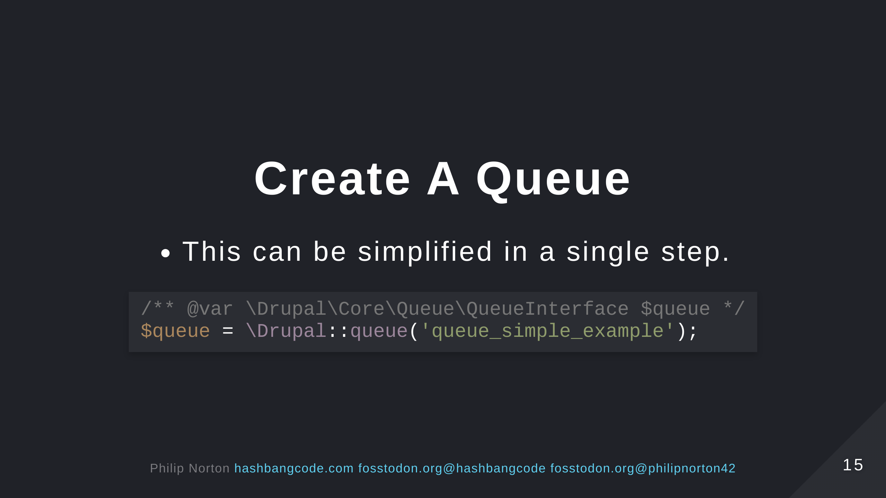

Slide 16
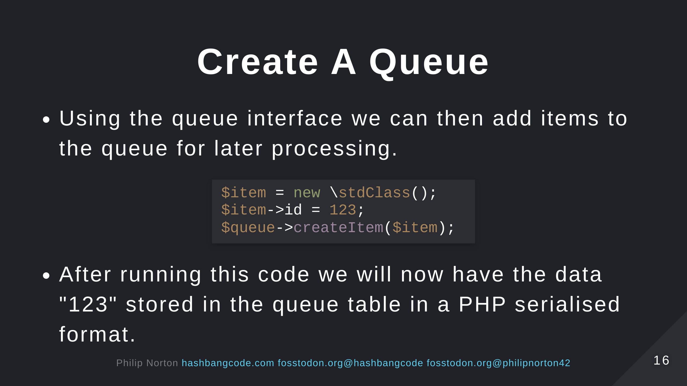

Slide 17
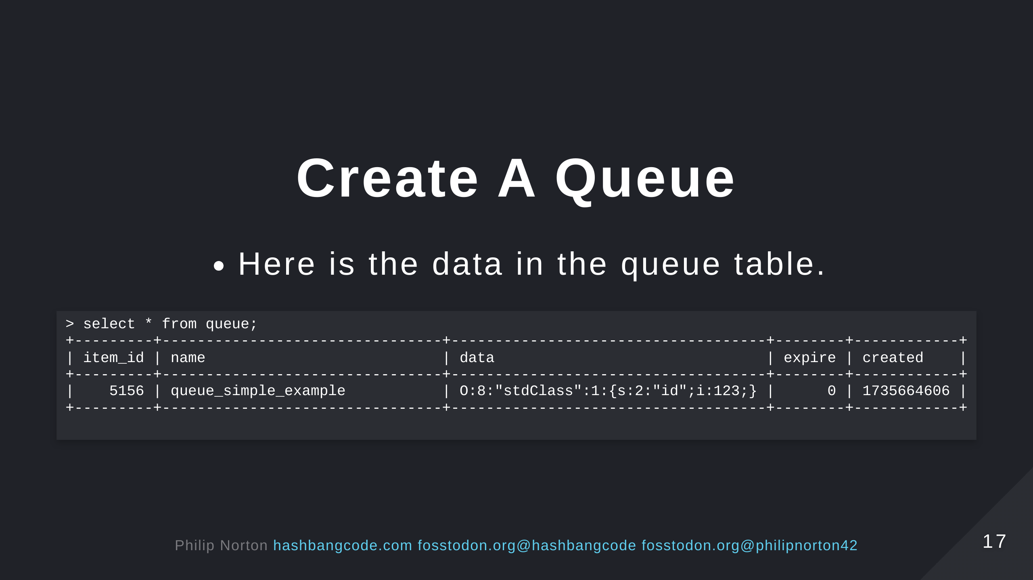
Notes:
The table columns are: - item_id = An auto increment field. - name = The name of the queue we created. - data = The serialised data in our queue. - expire = When the queue item is picked up for processing the expire time is set to 1 hour in the future. The item can get placed back into the queue, but will be picked back up if the expire time is in the past. - created = When the queue item was created.

Slide 18
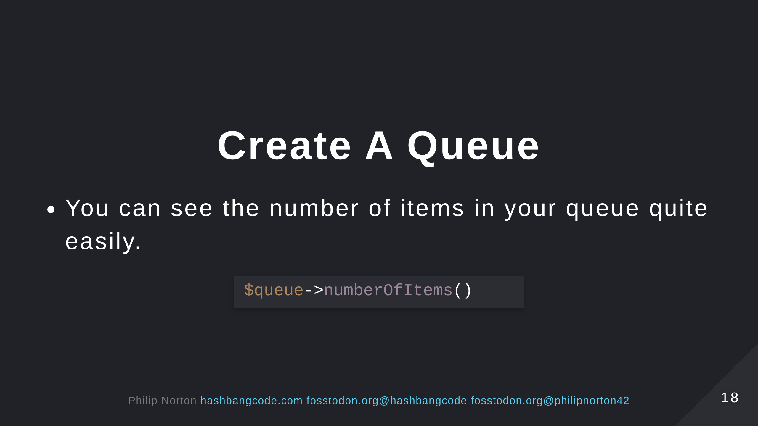

Slide 19
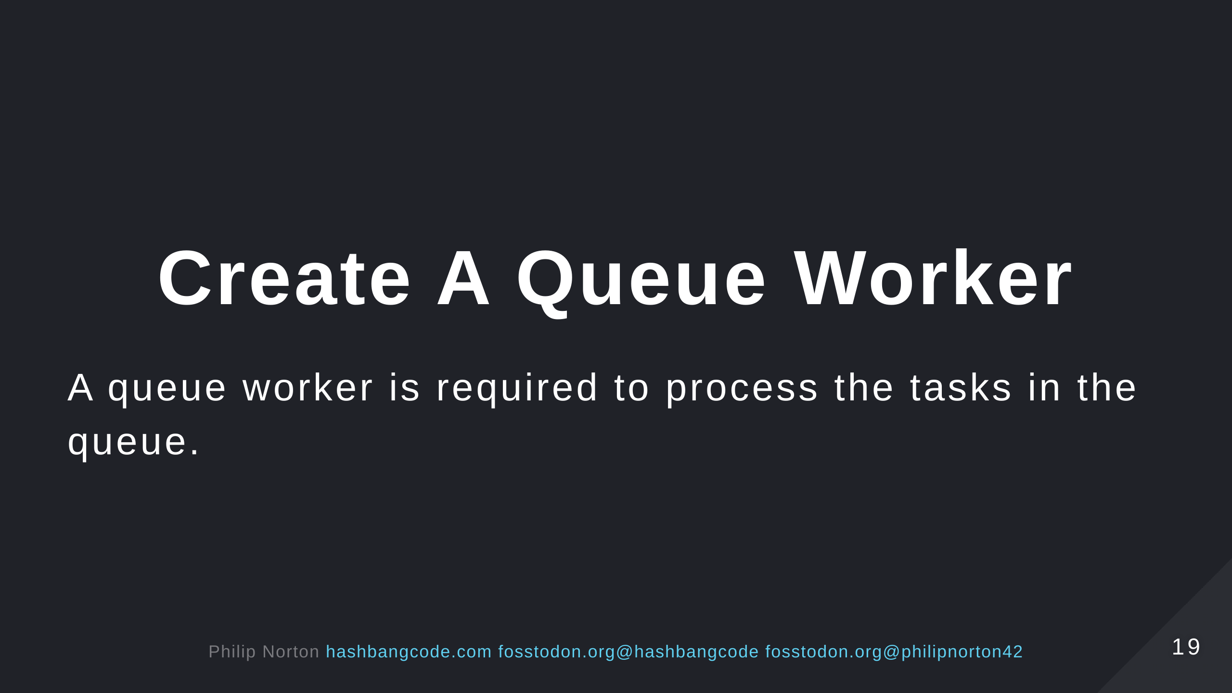

Slide 20
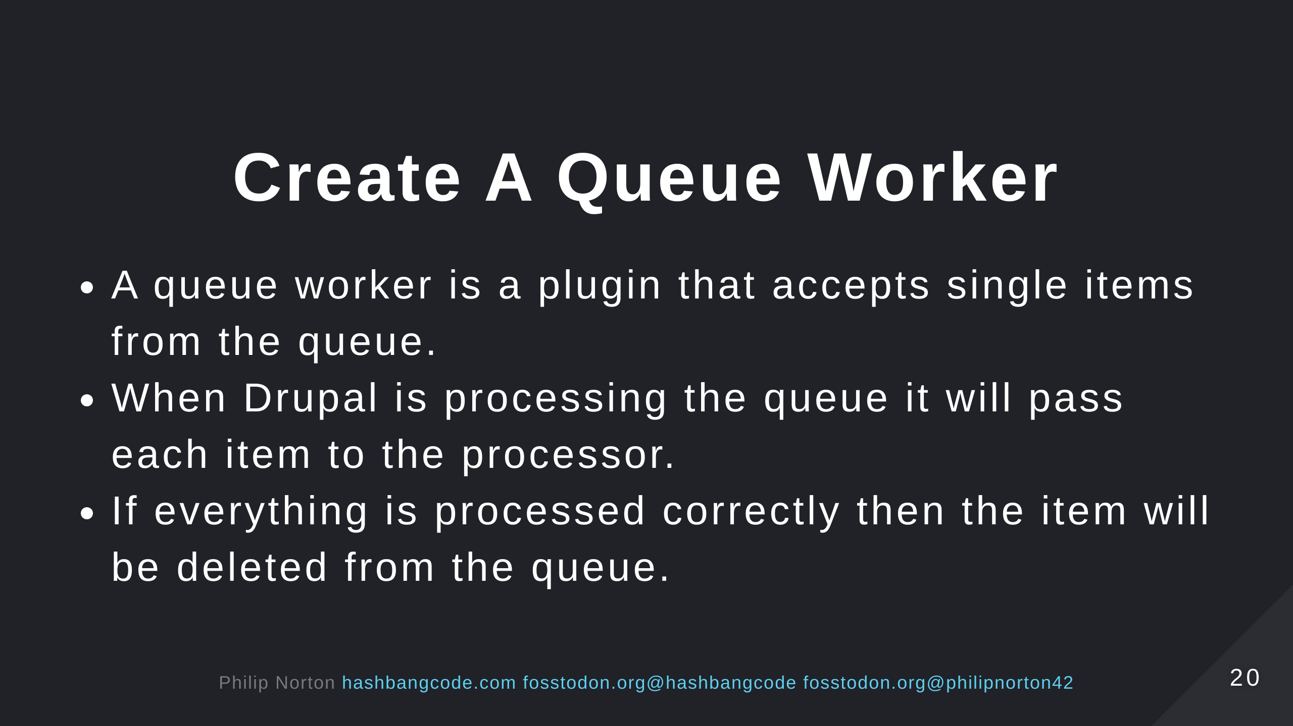
Notes:
The assumption is that if you didn't throw an error then the item should be removed.

Slide 21
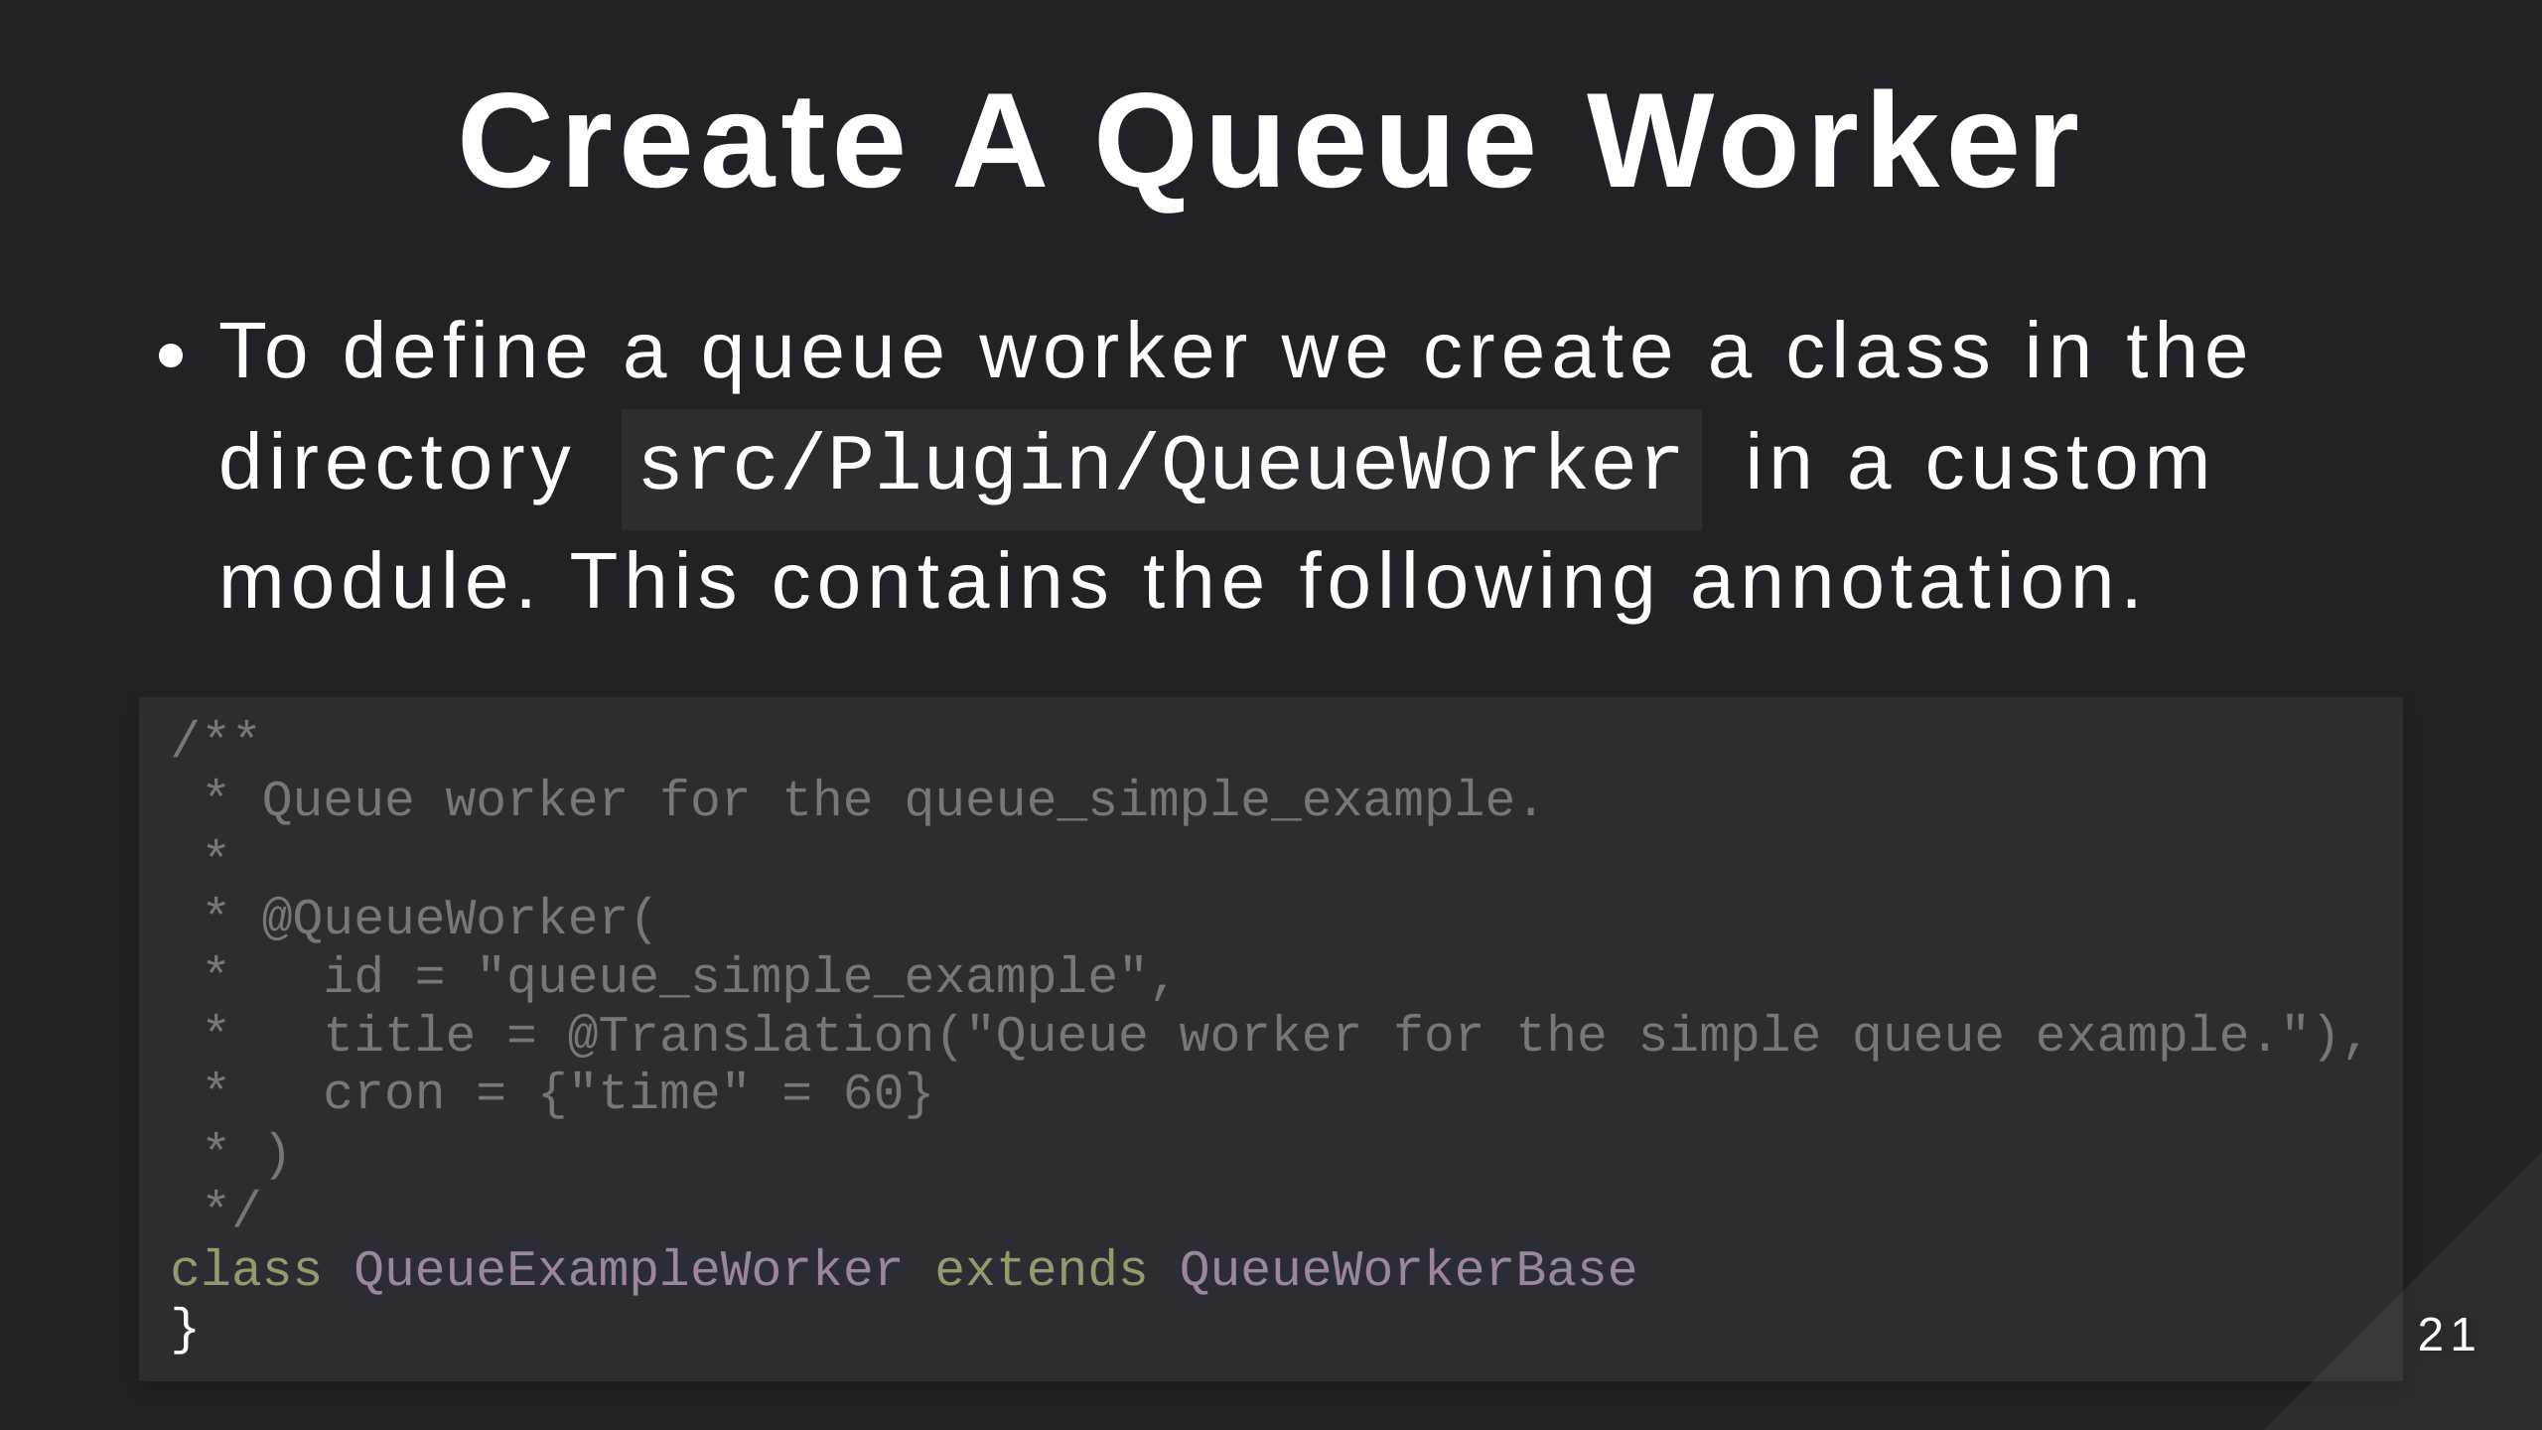

Slide 22
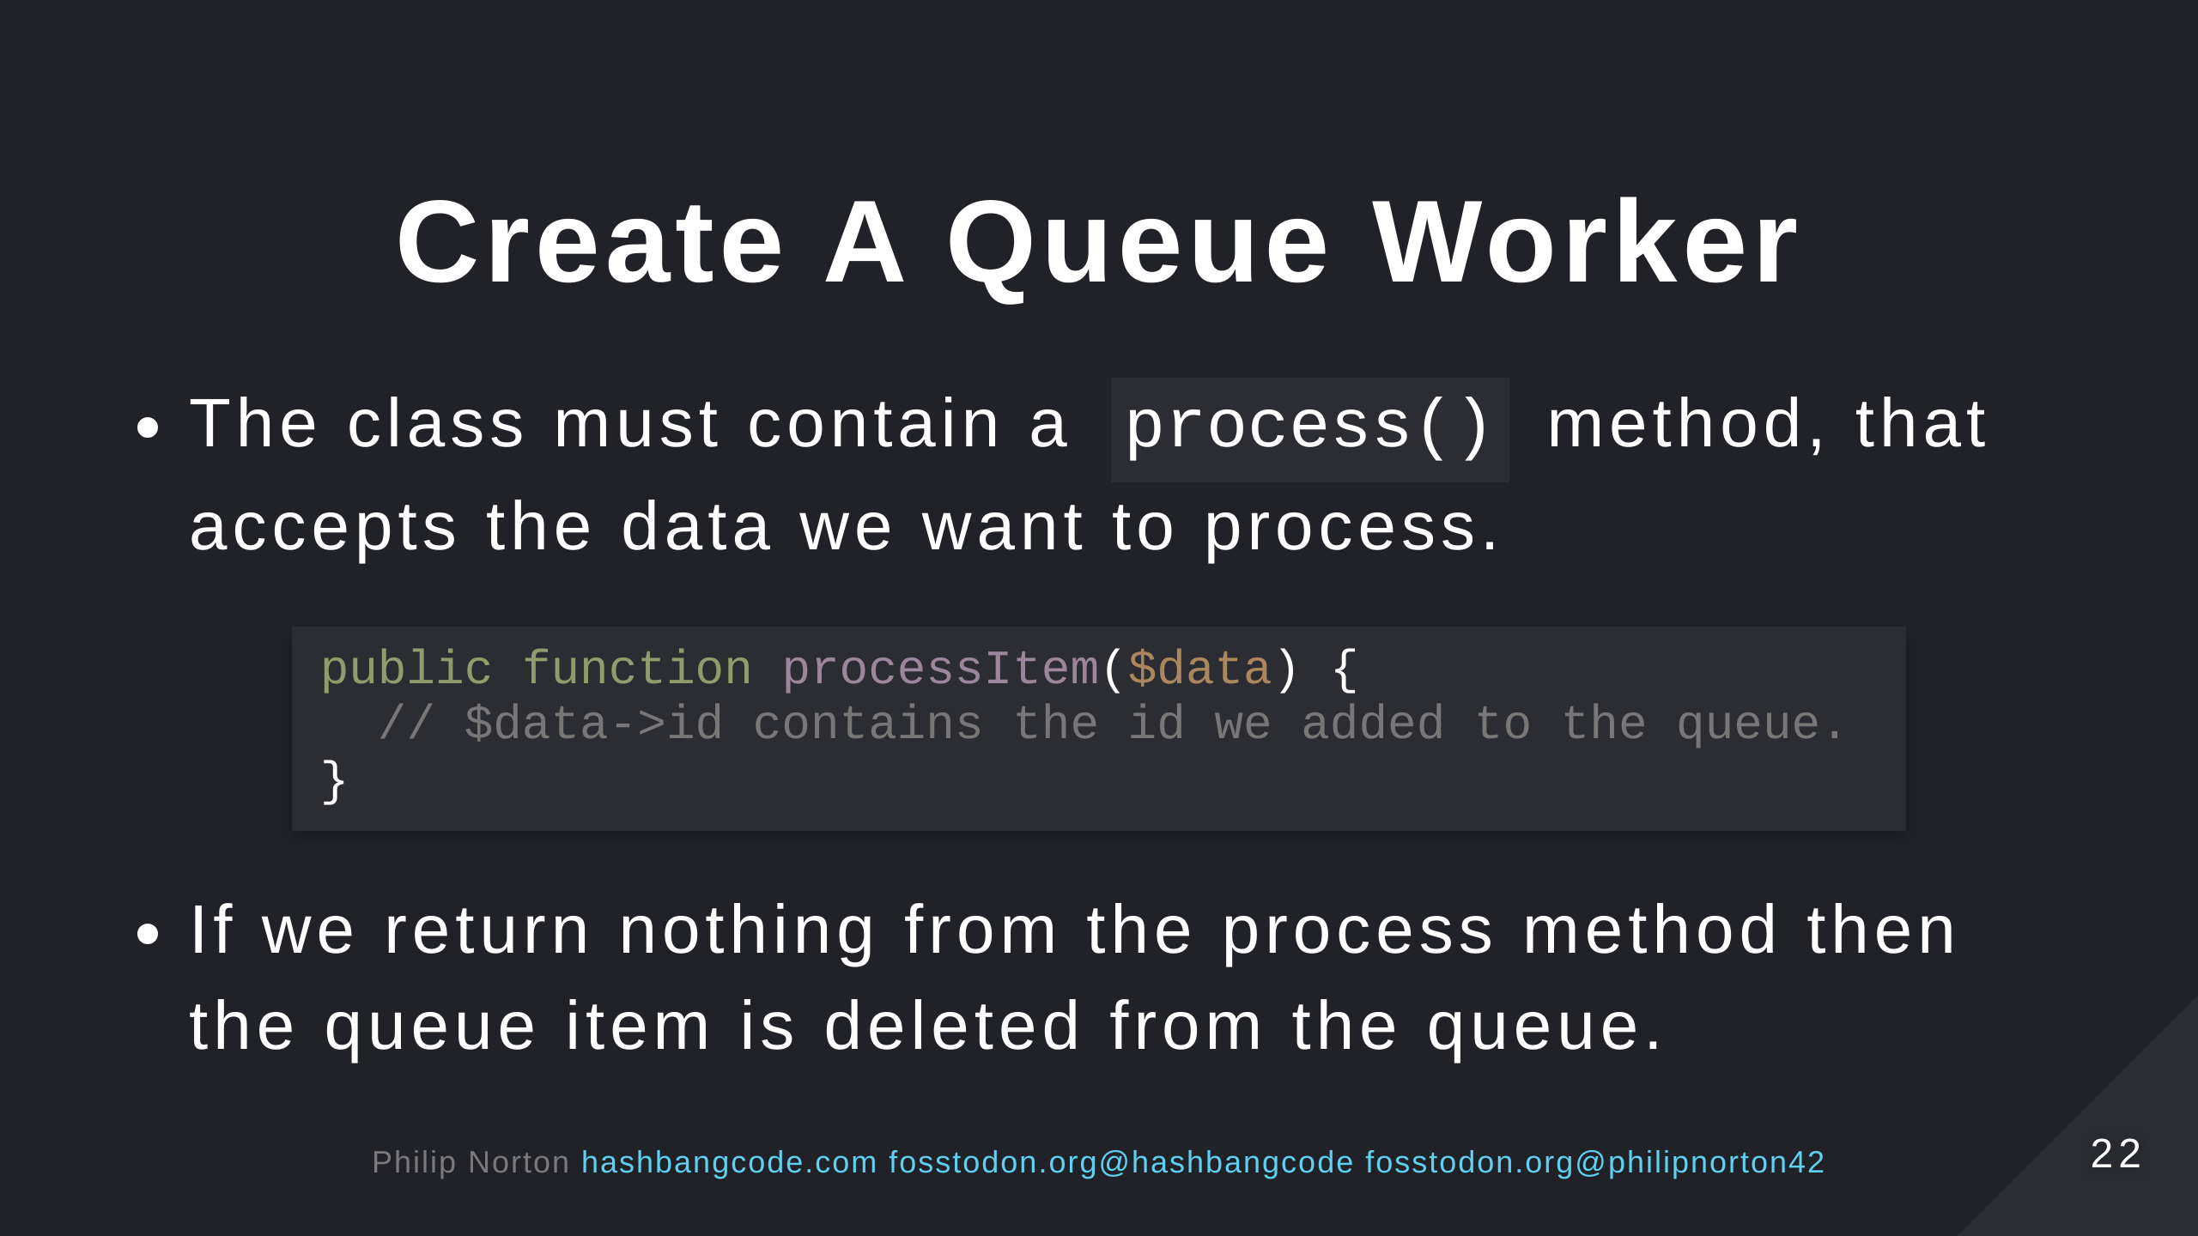

Slide 23
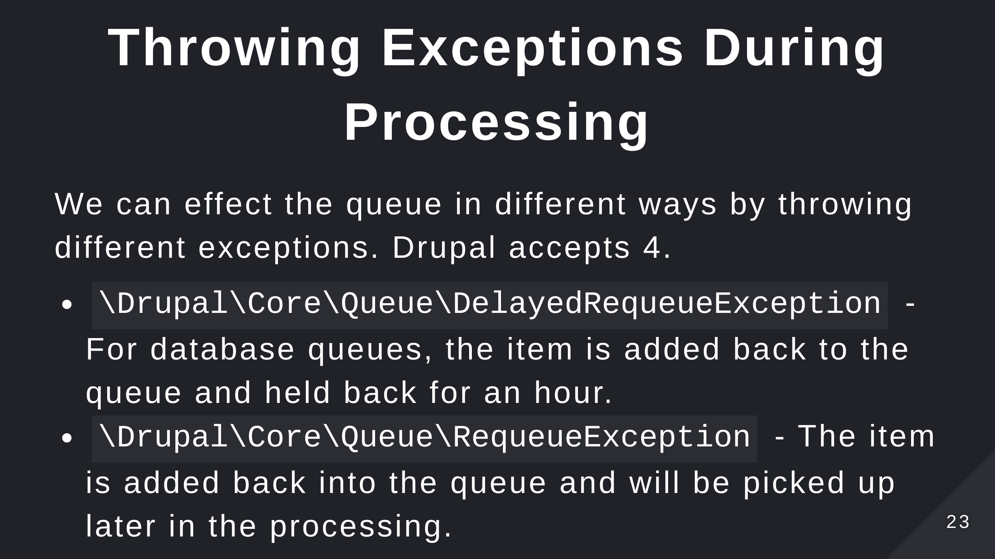
Notes:
Remember the queue structure. If we throw an item into the queue we put it back to the processing list.

Slide 24
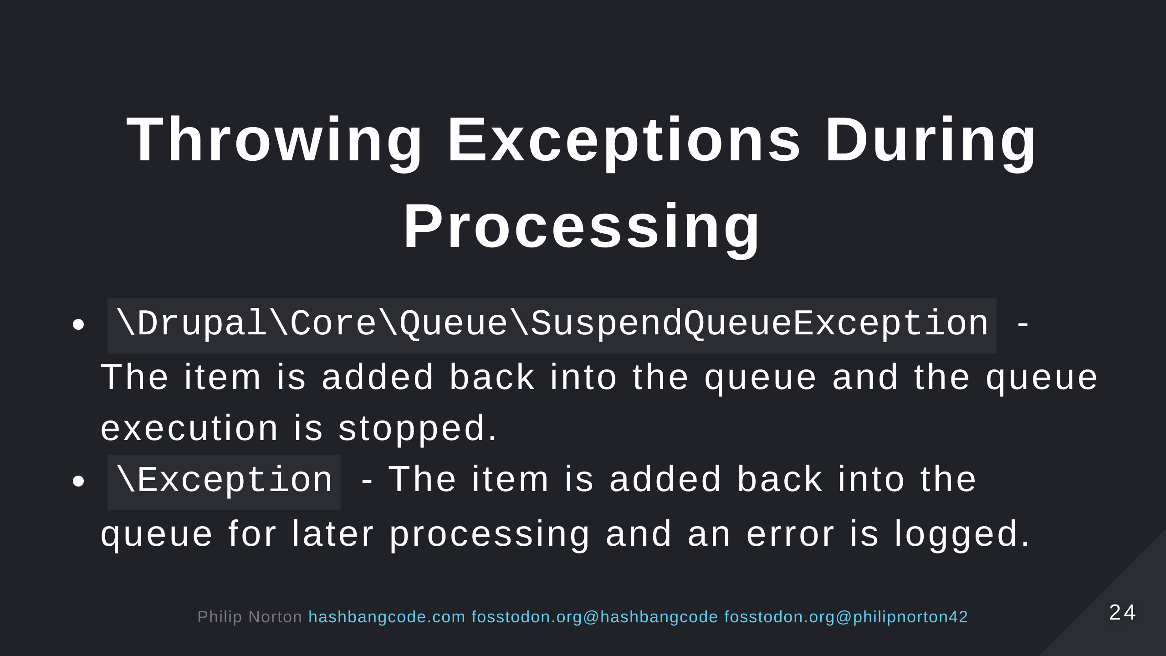

Slide 25
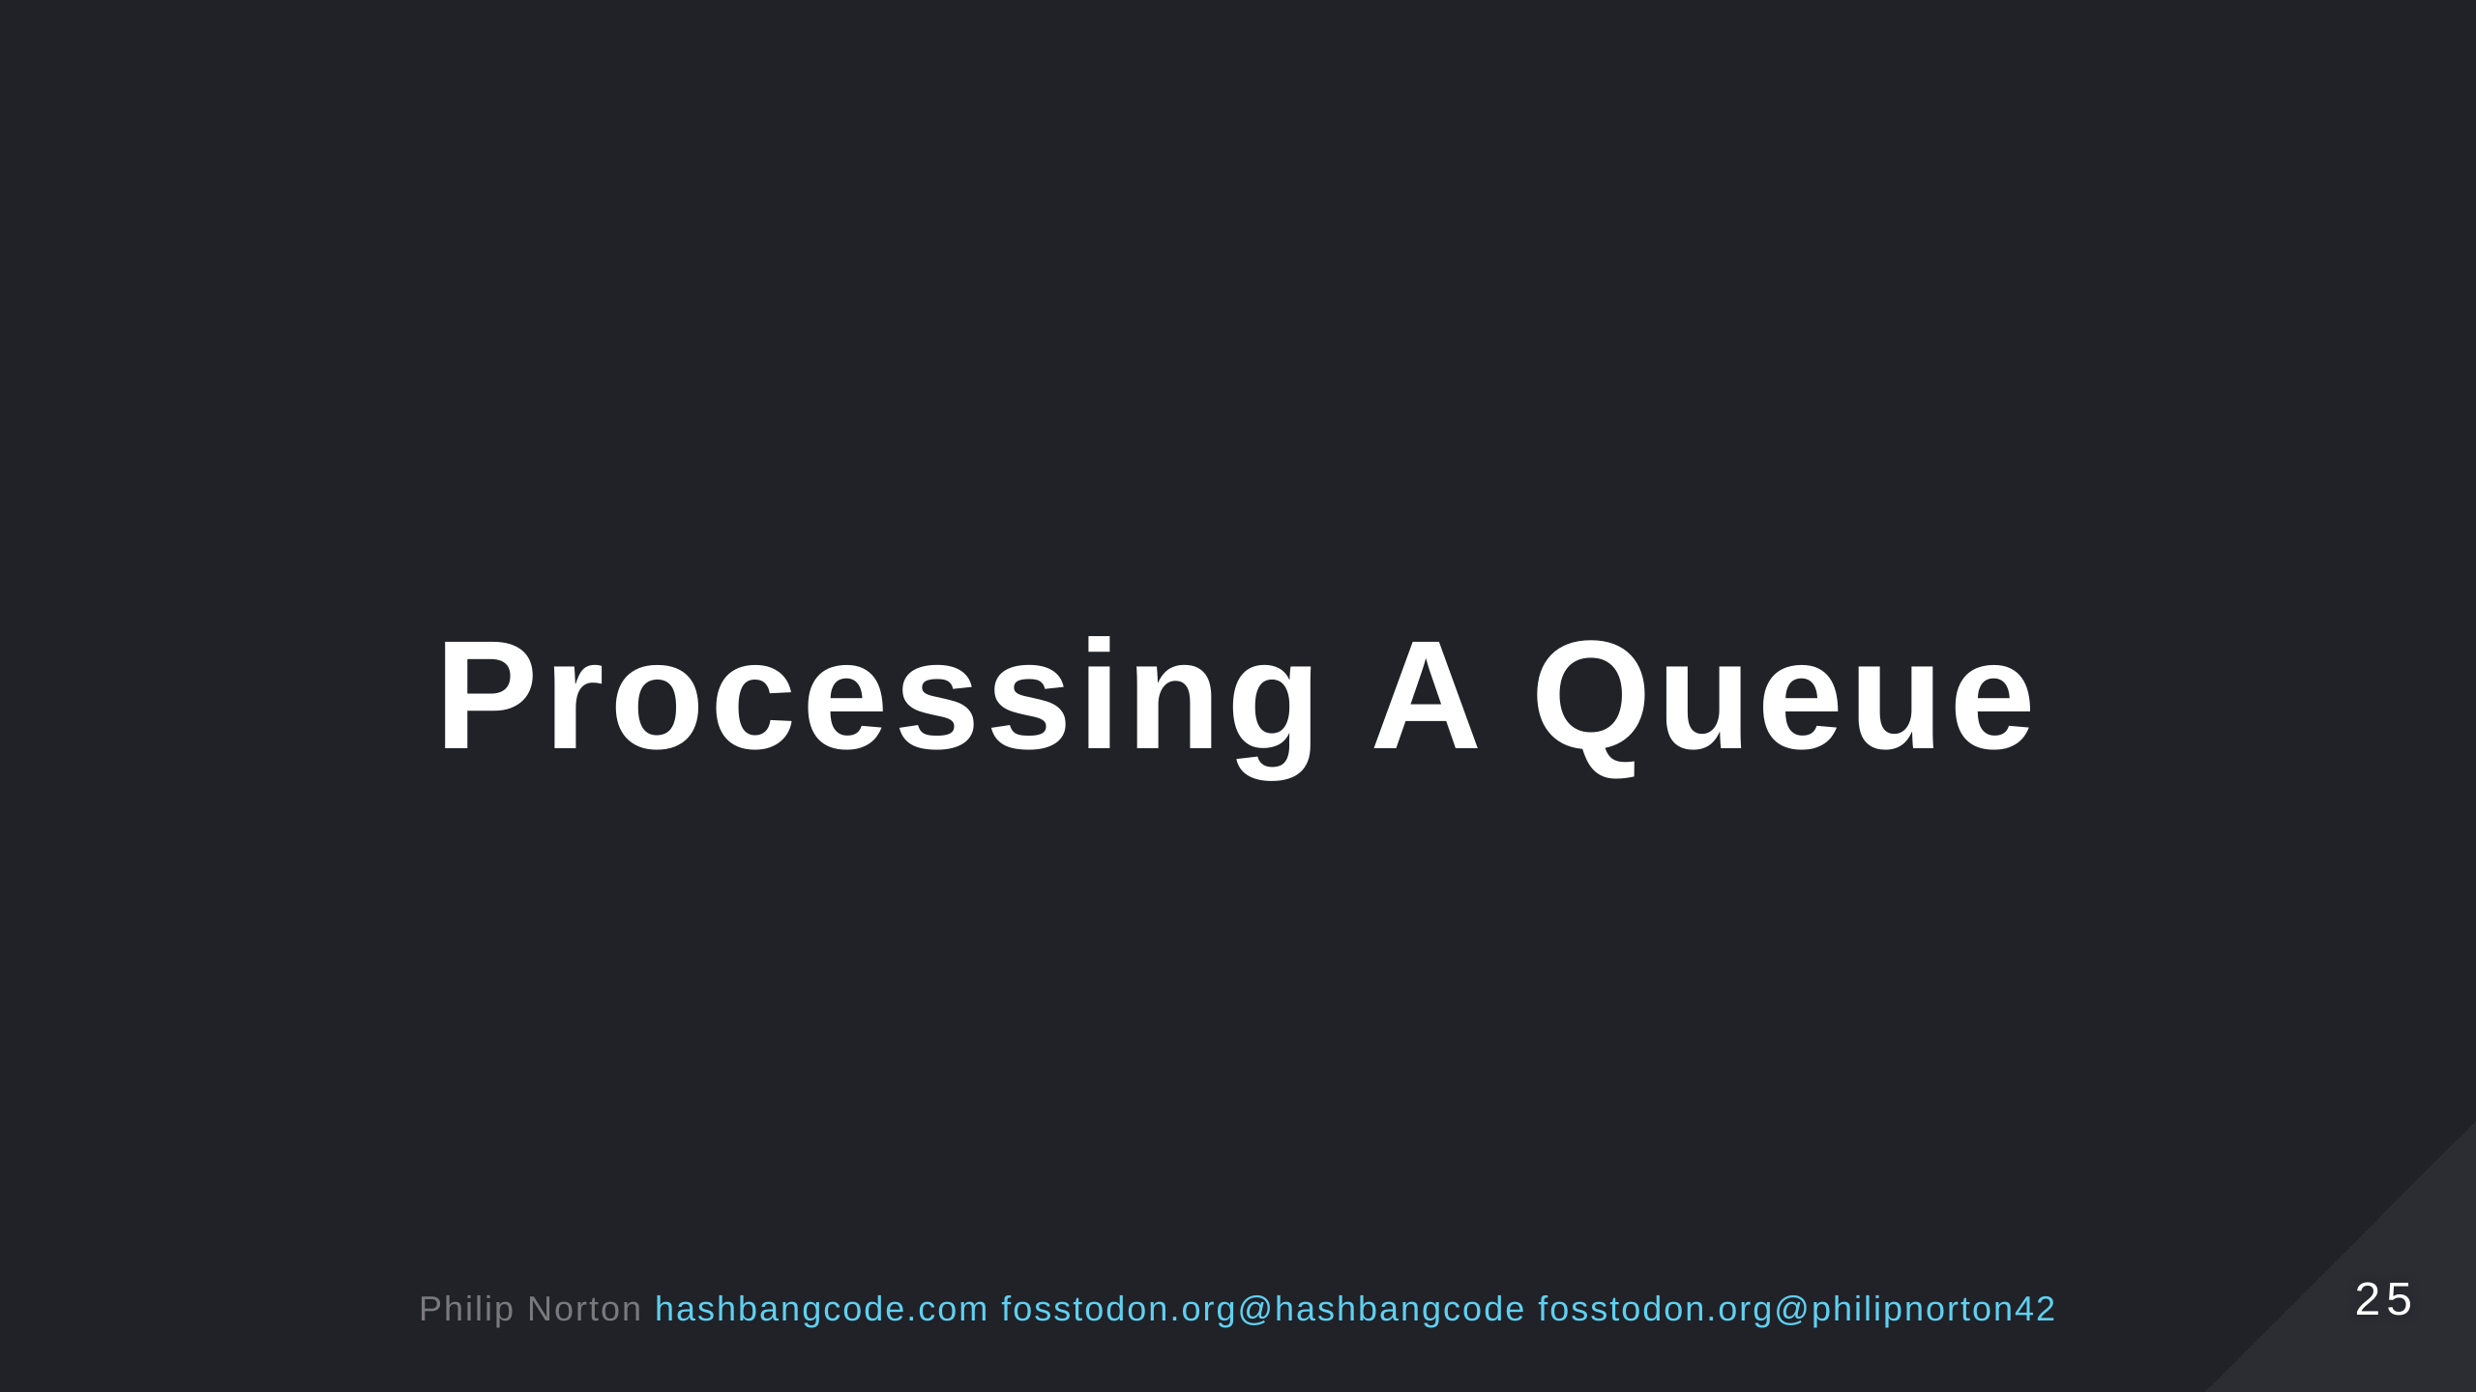

Slide 26
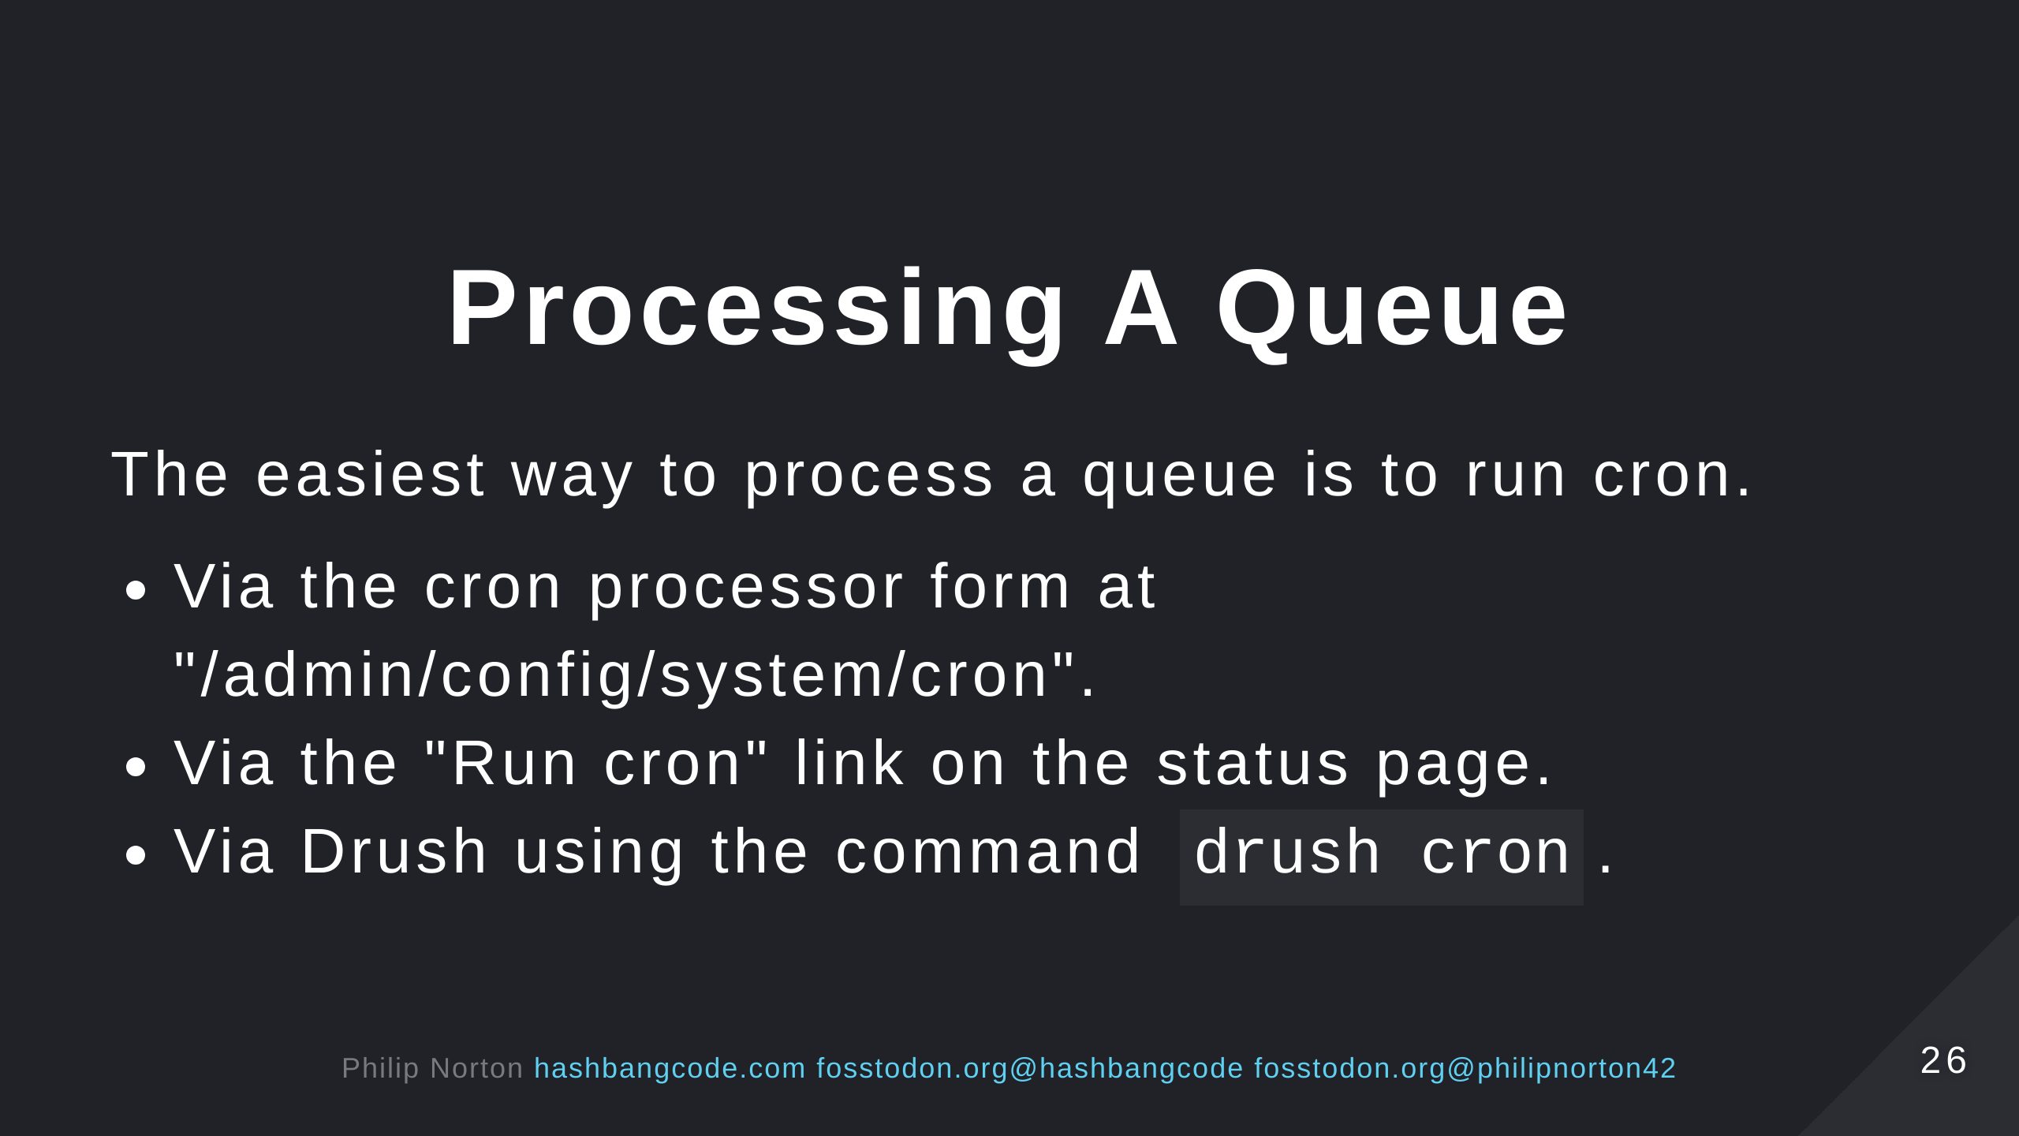

Slide 27
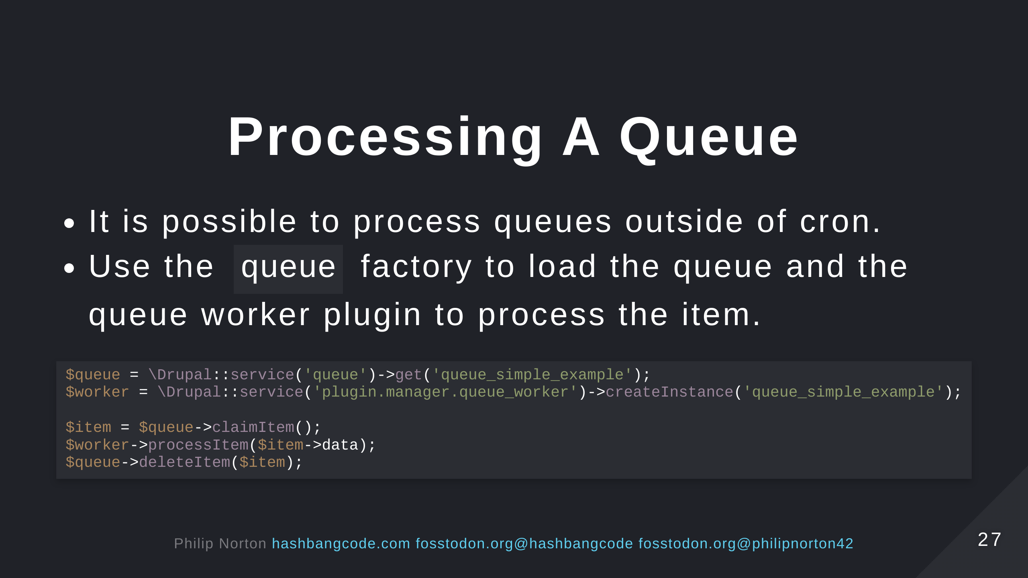

Slide 28
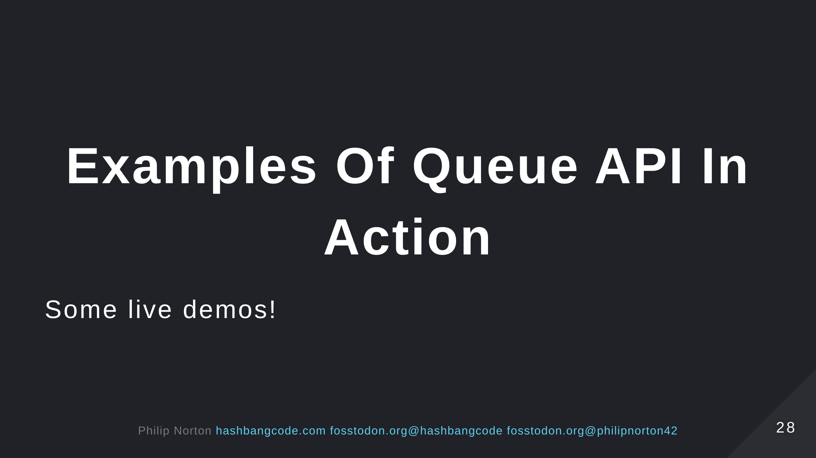

Slide 29
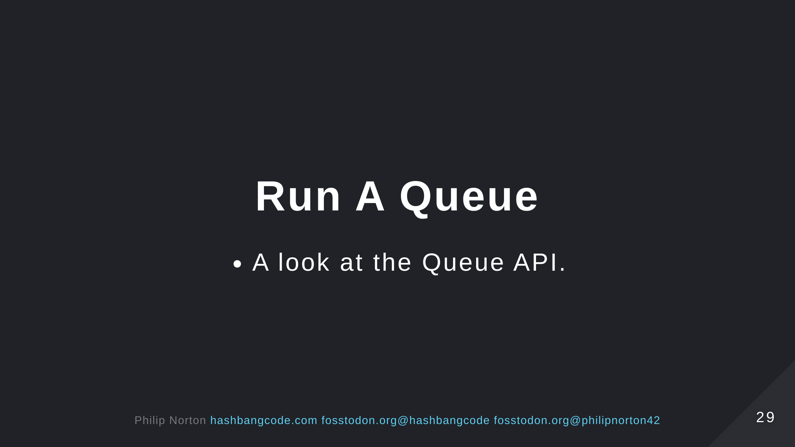

Slide 30
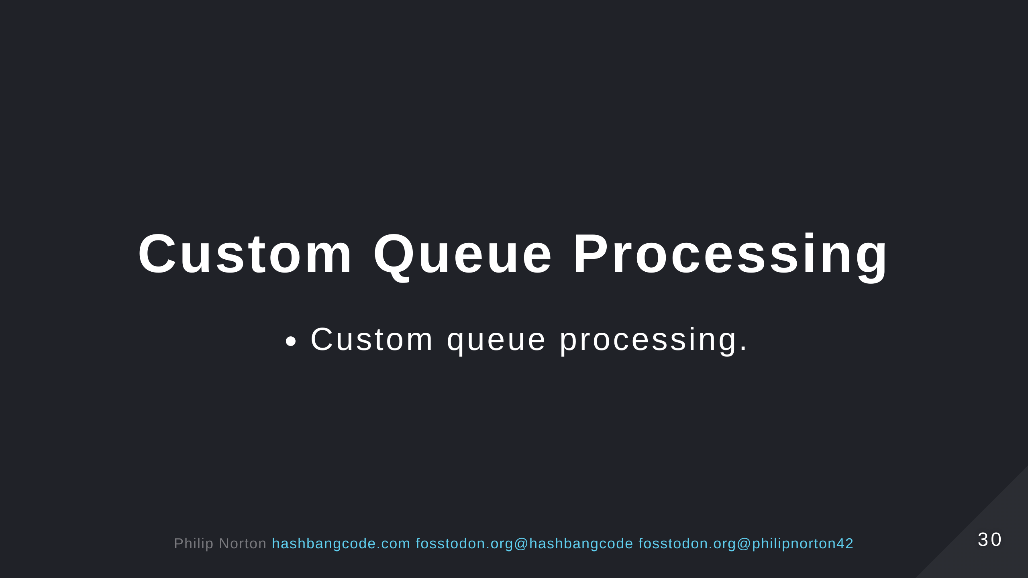

Slide 31
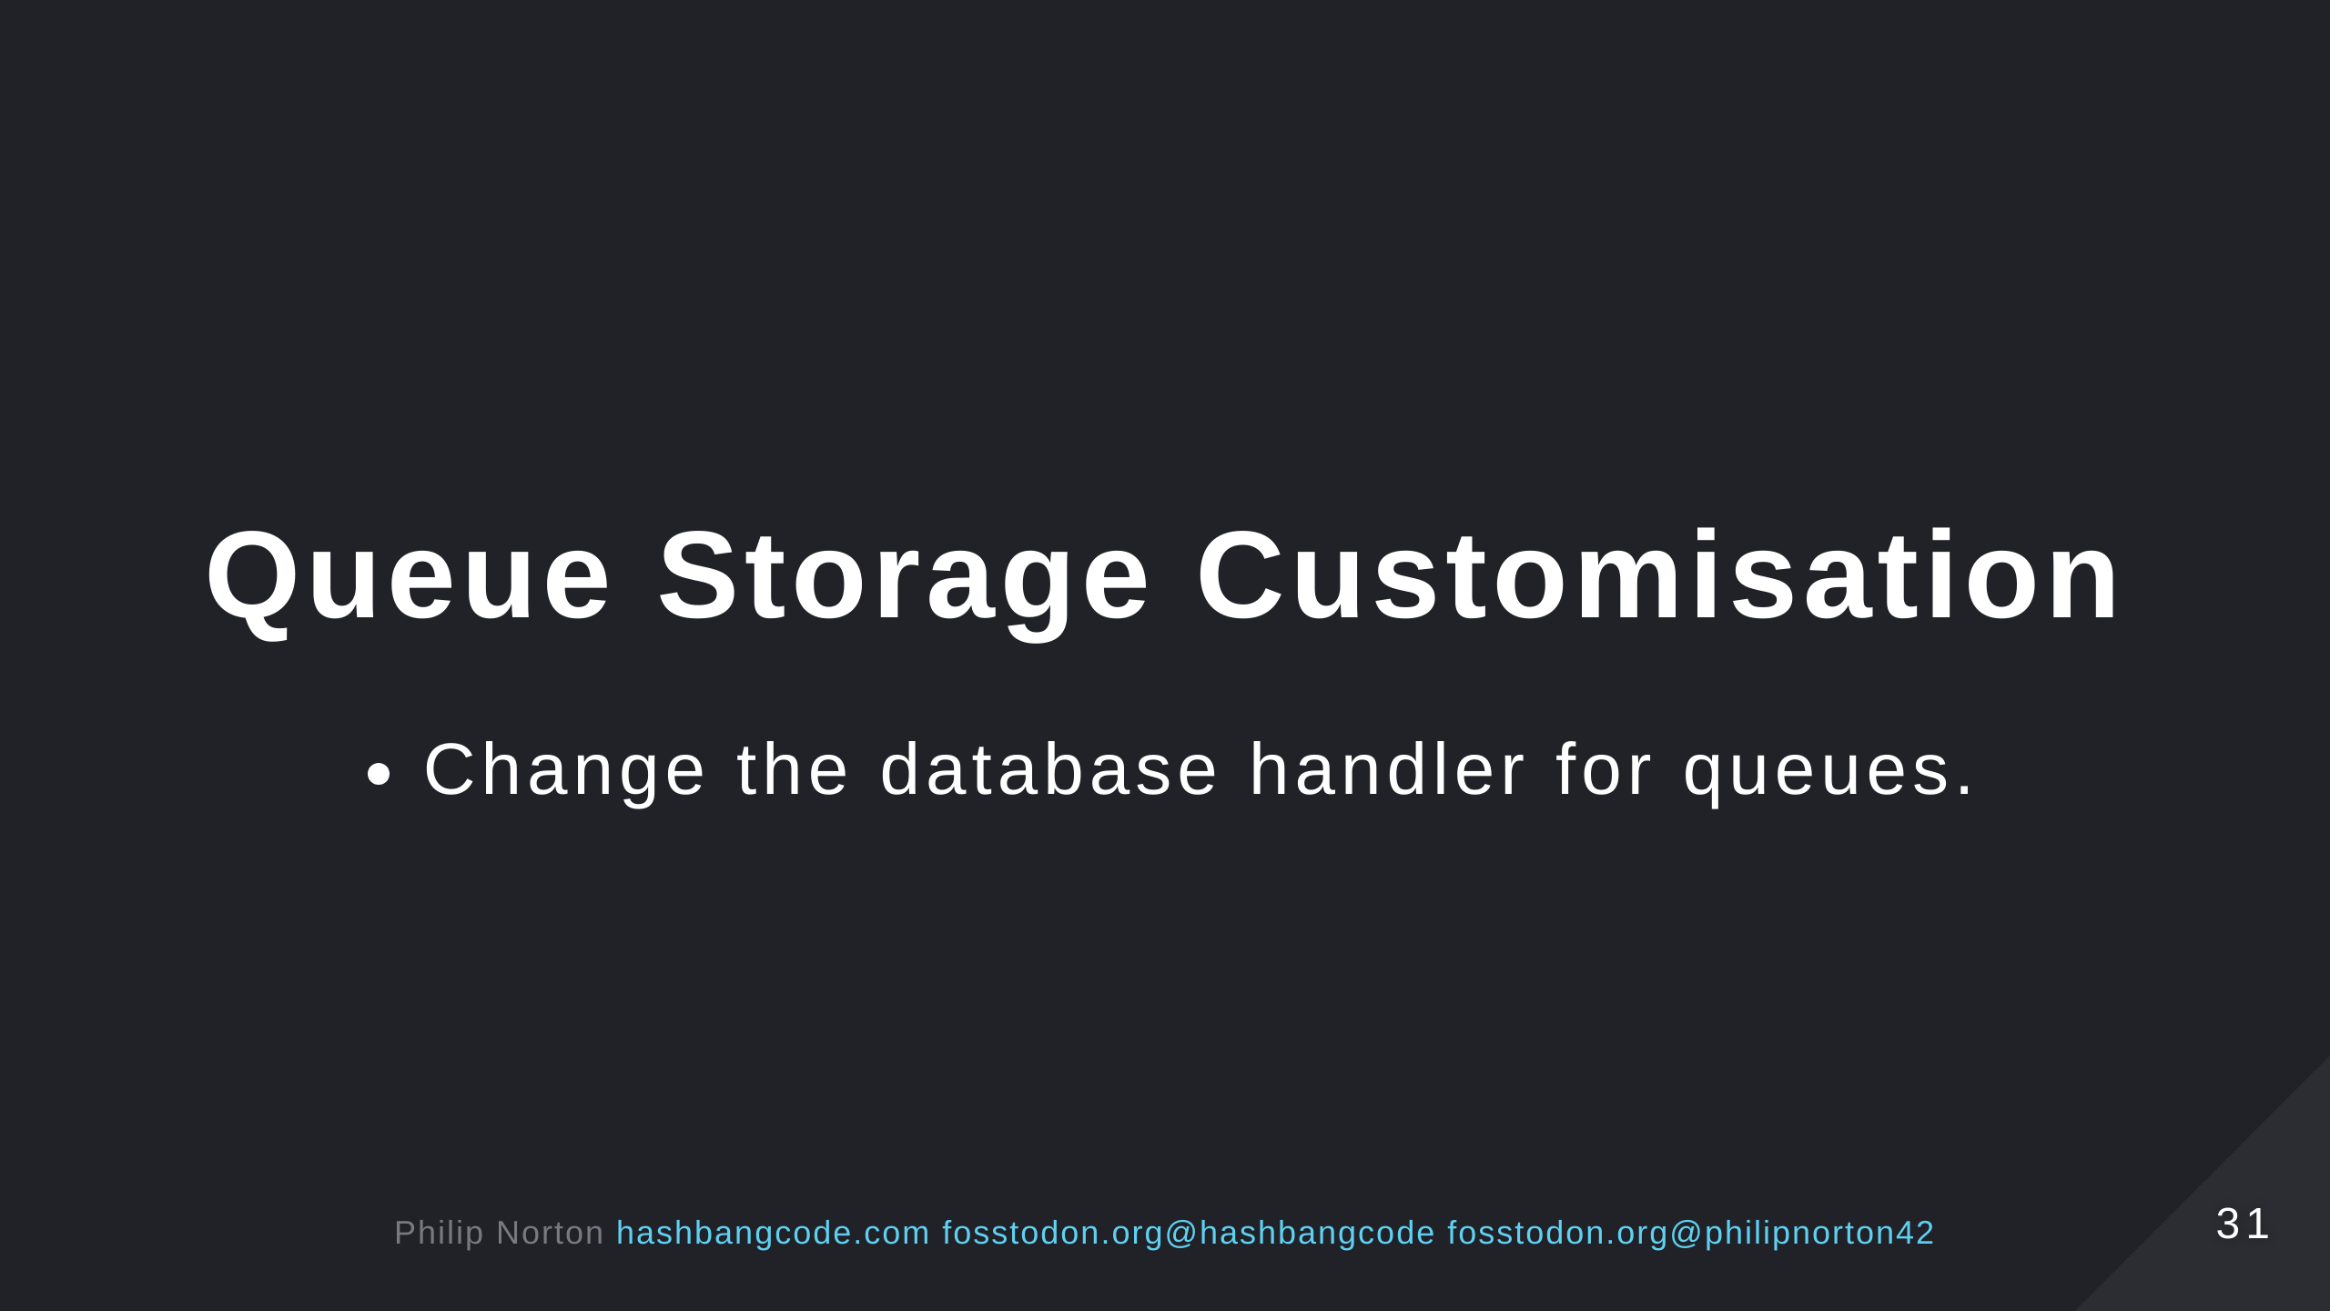

Slide 32


Slide 33
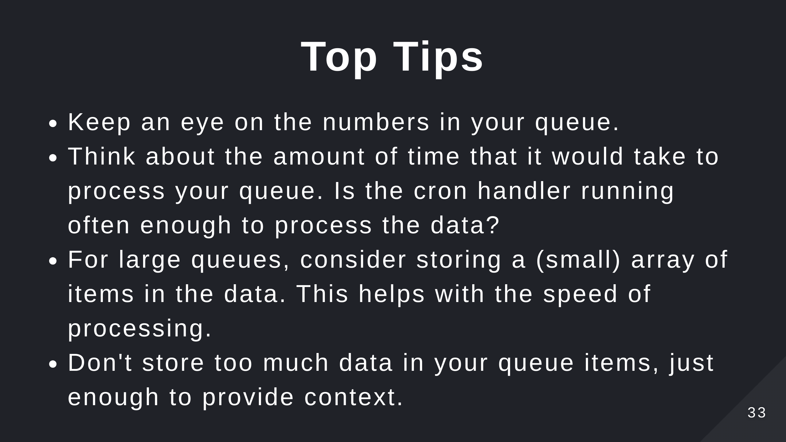

Slide 34
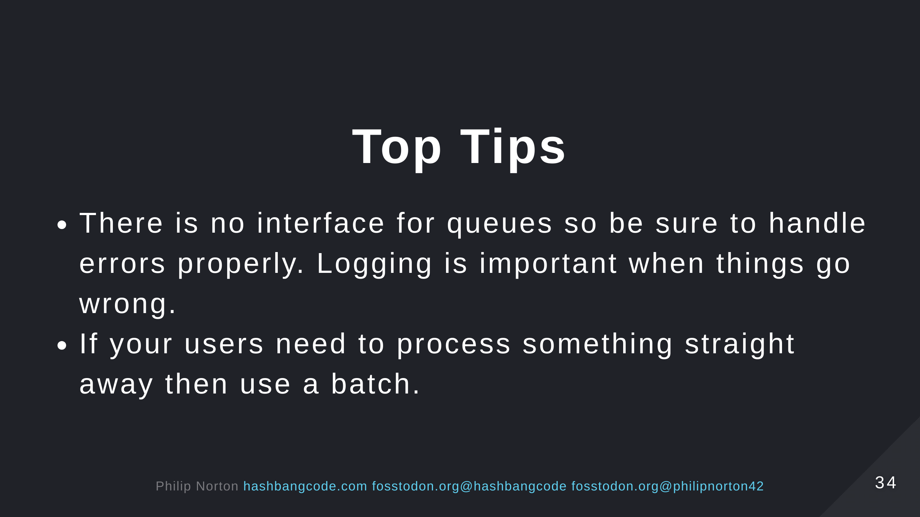

Slide 35
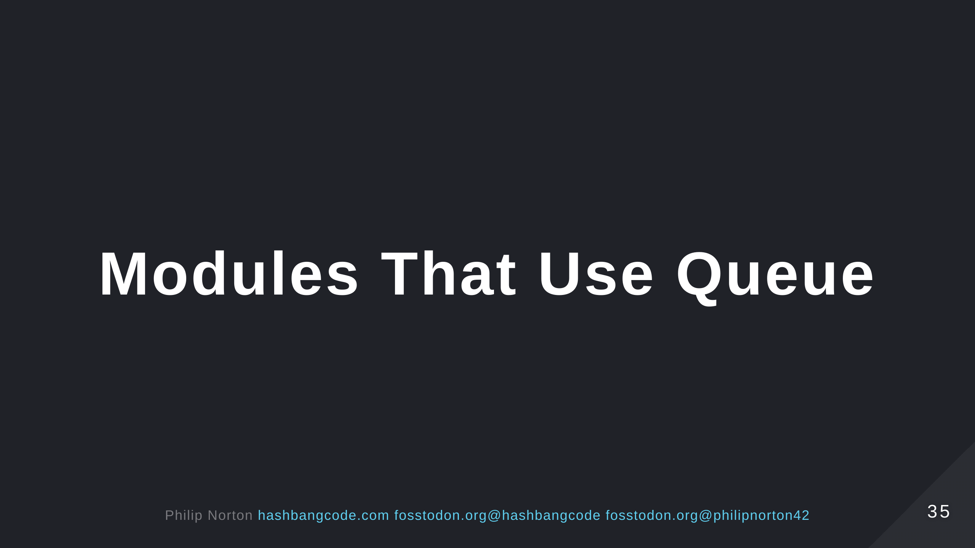

Slide 36
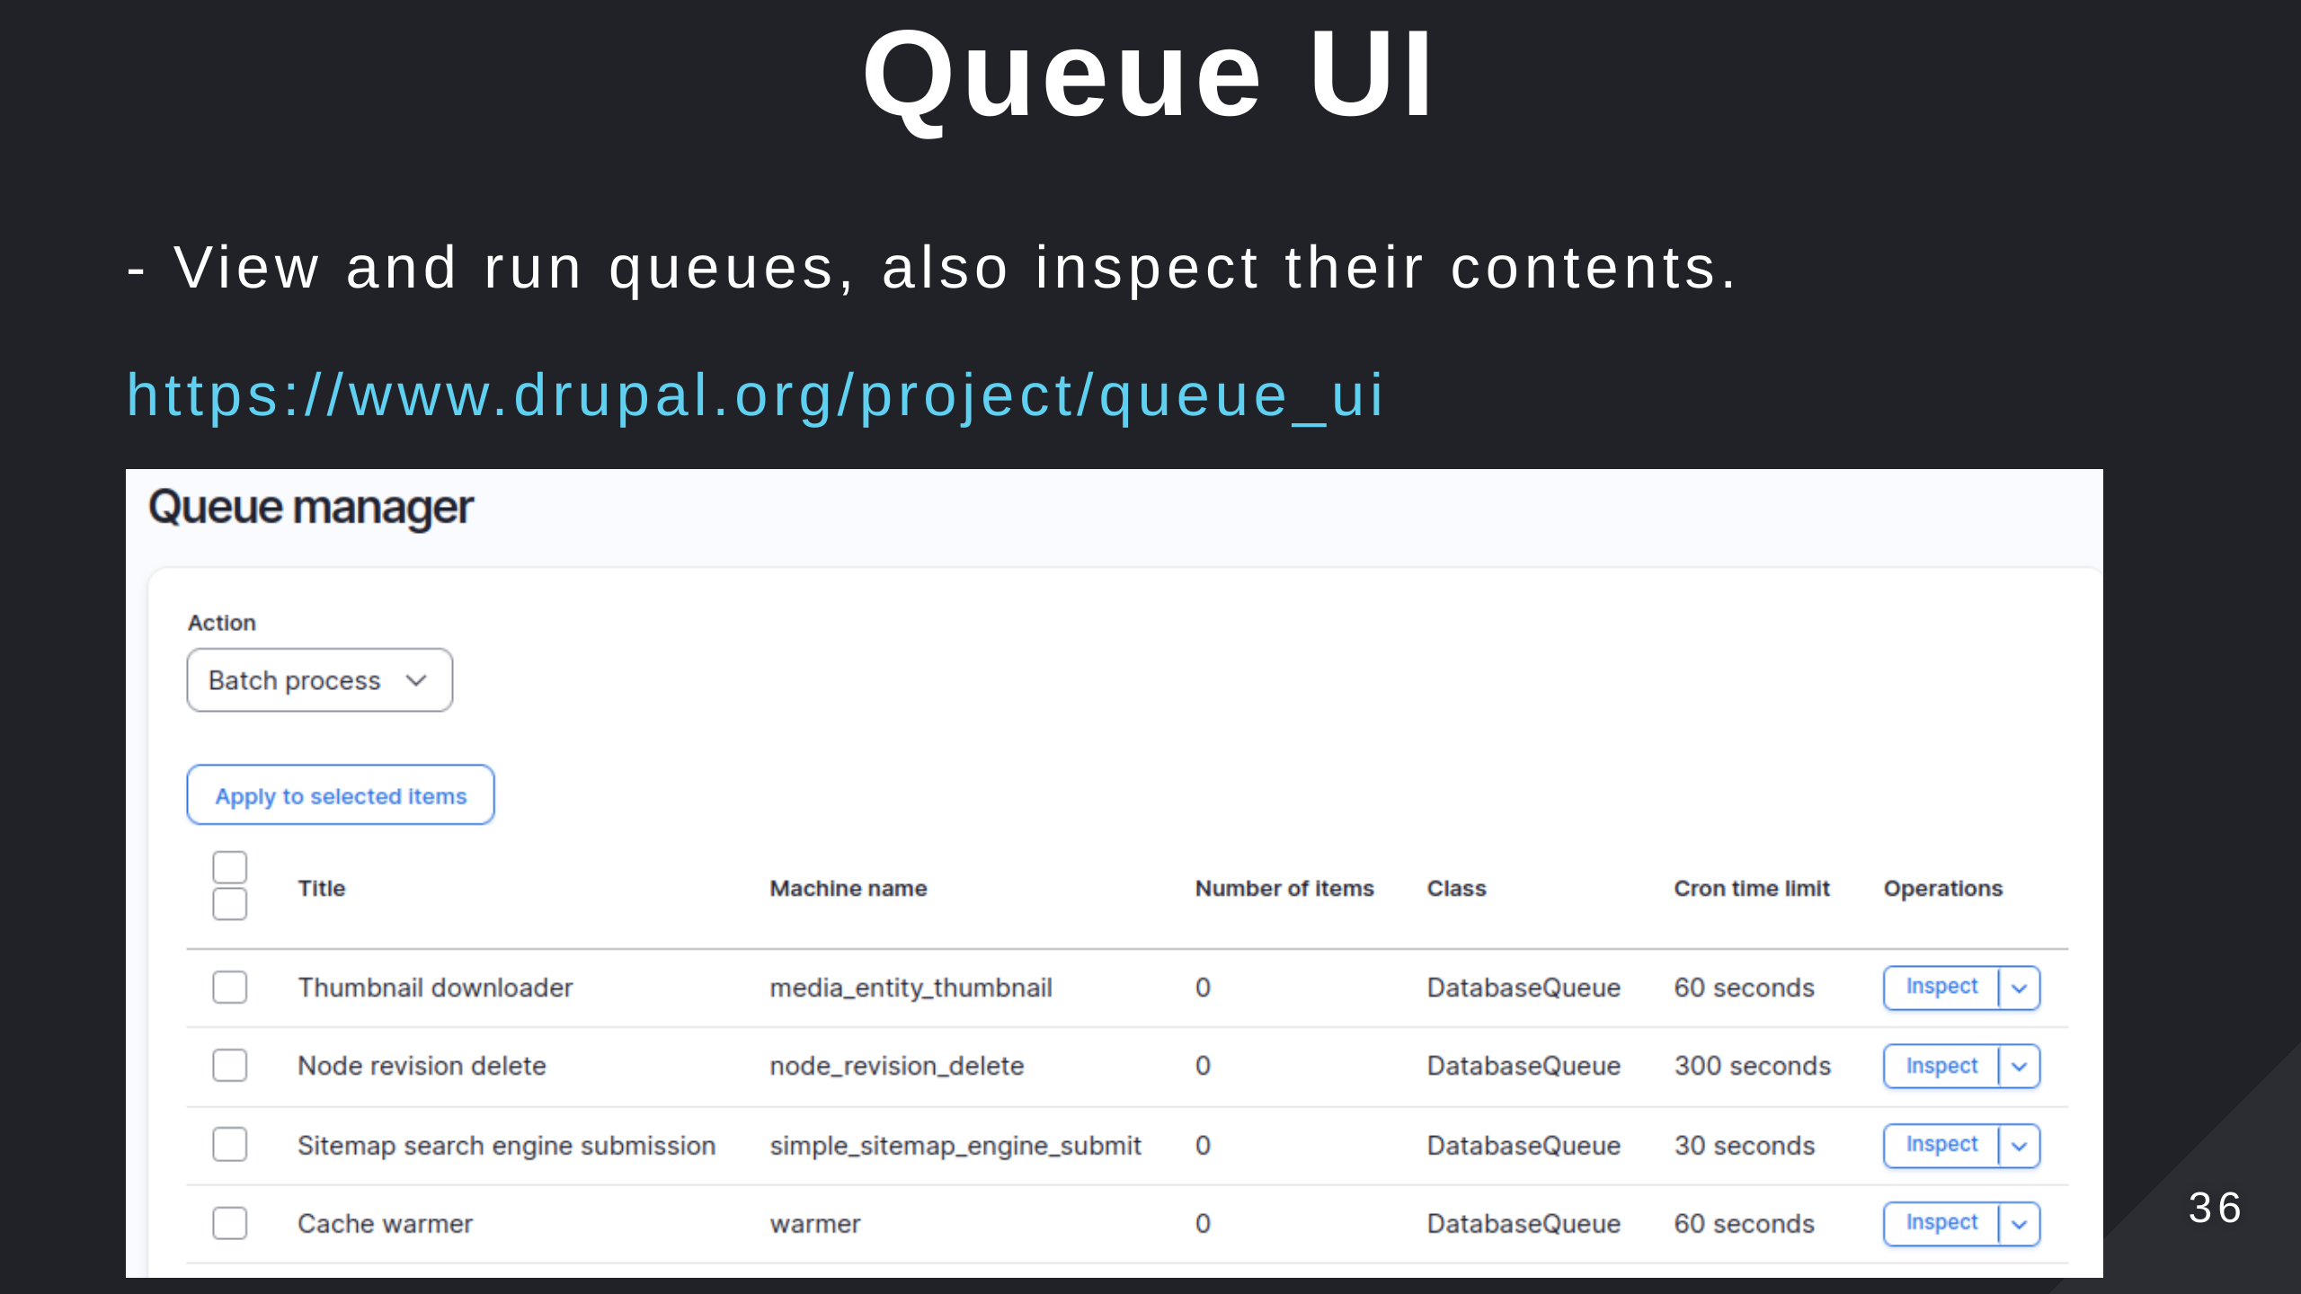

Slide 37
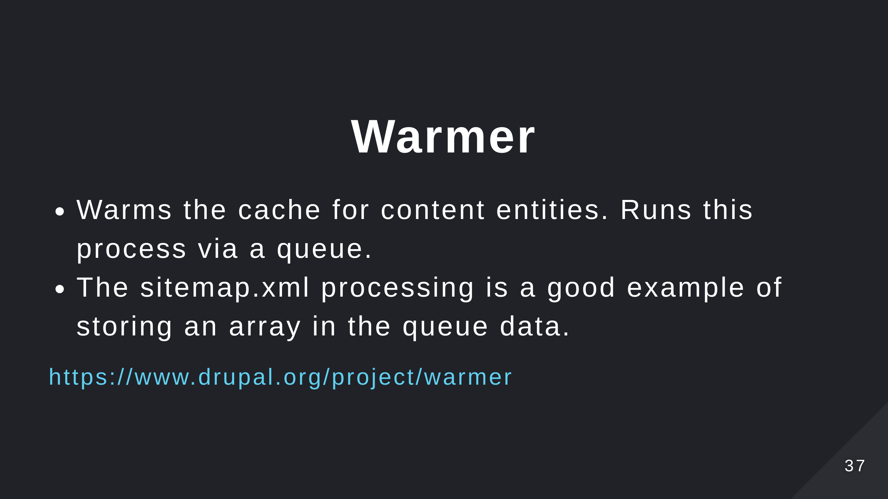

Slide 38
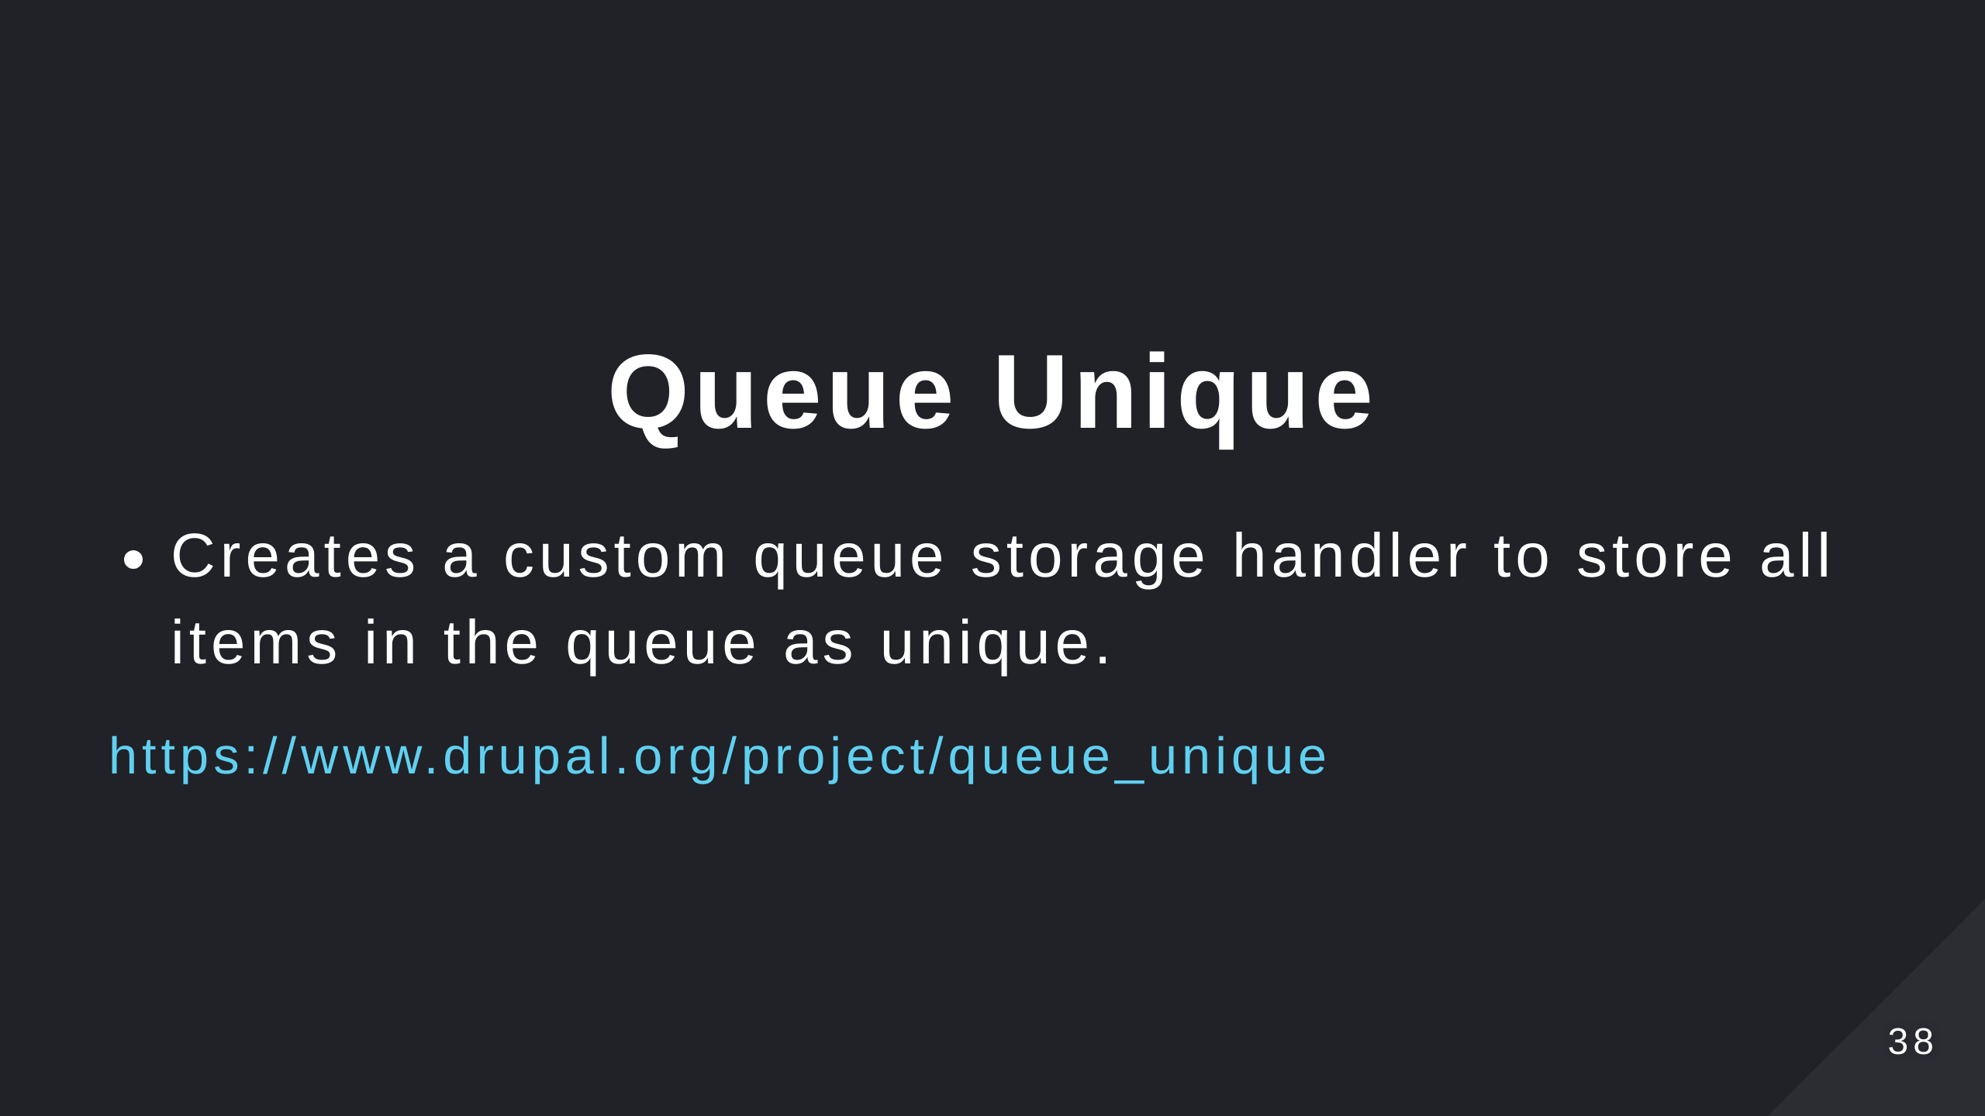

Slide 39
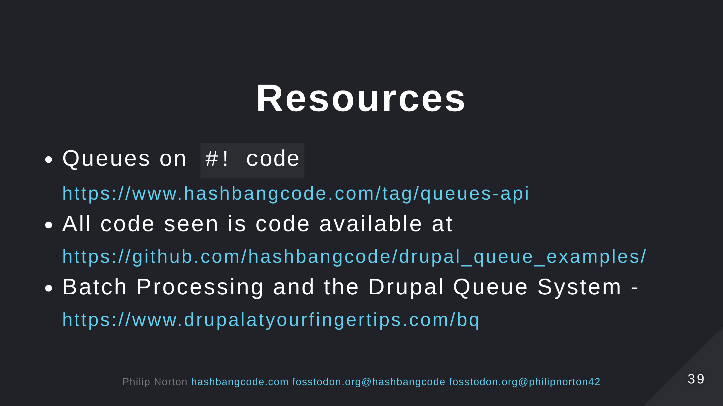
Notes:
- See the list at the repo page https://github.com/hashbangcode/drupal-queue-api-talk.

Slide 40
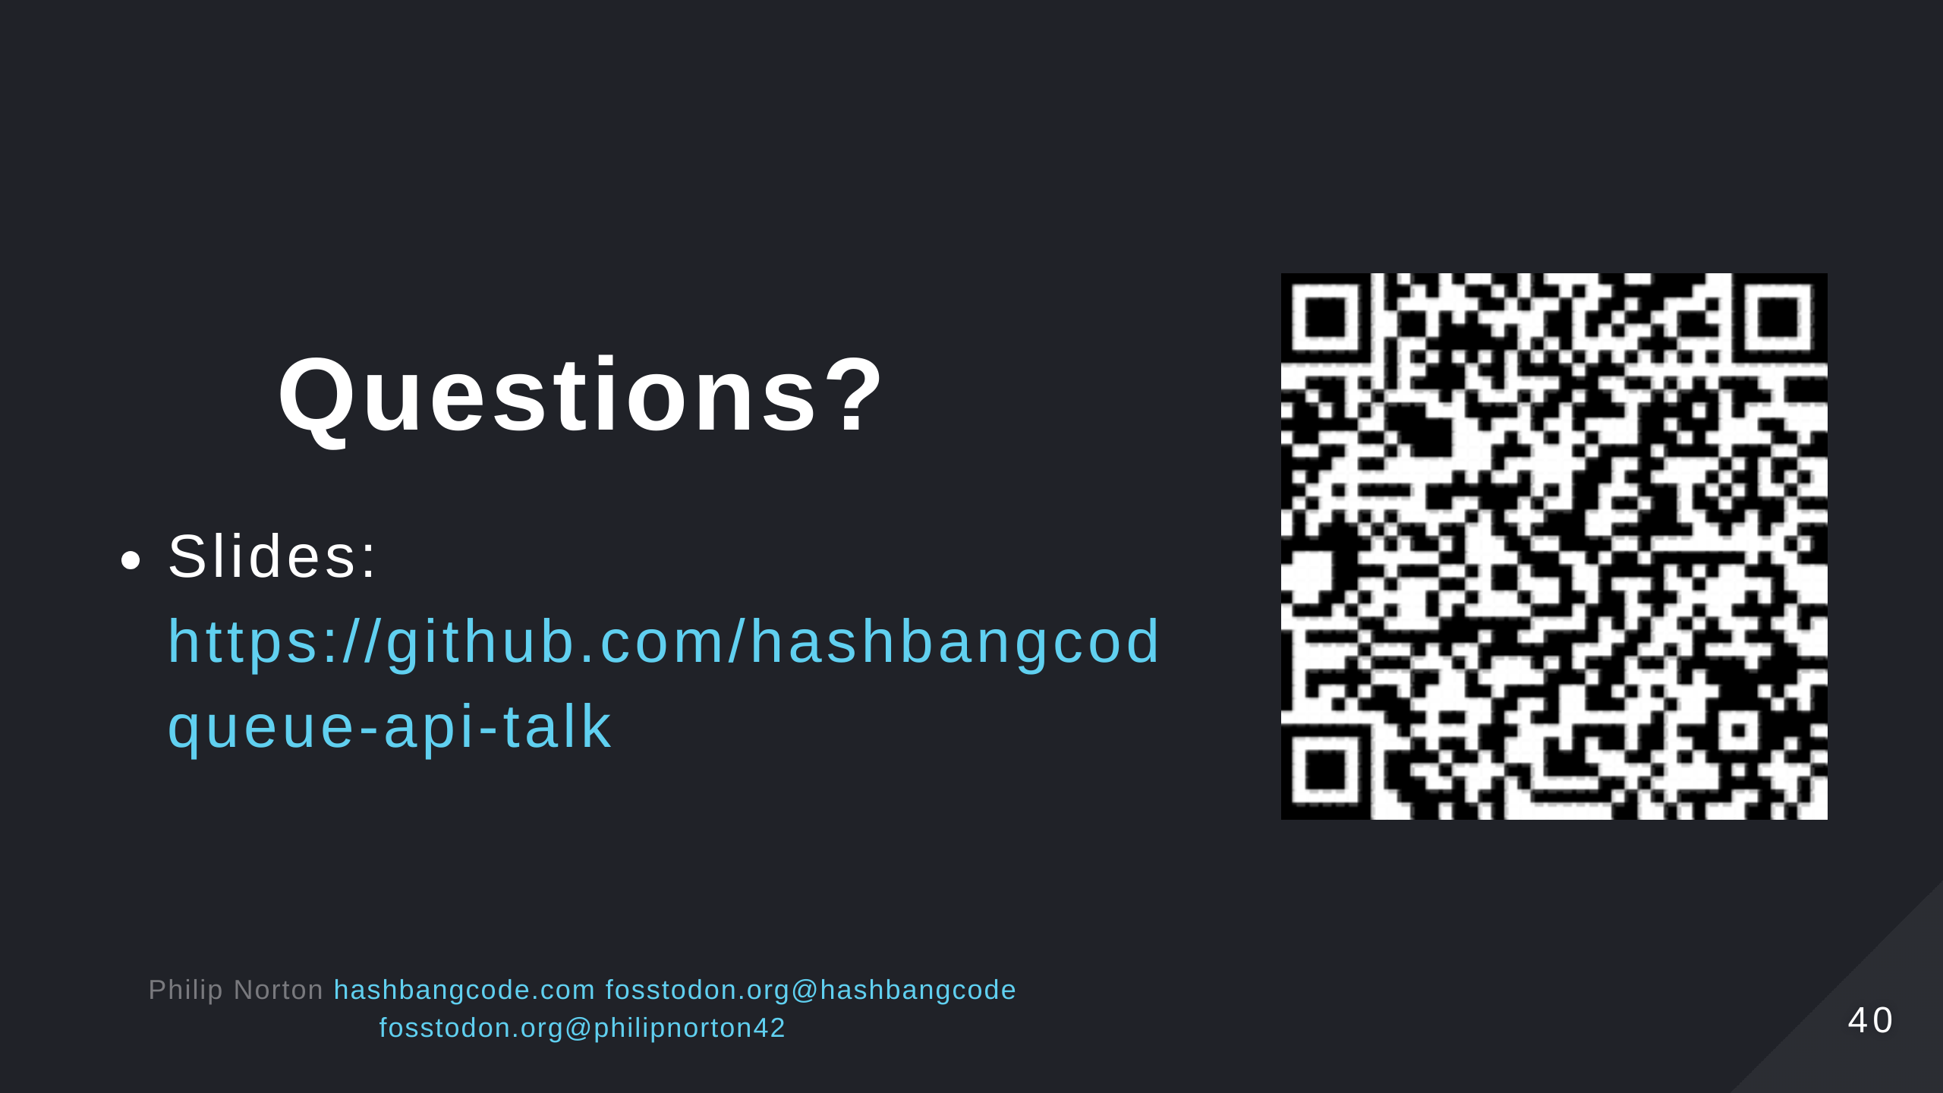

Slide 41
